Slide 1
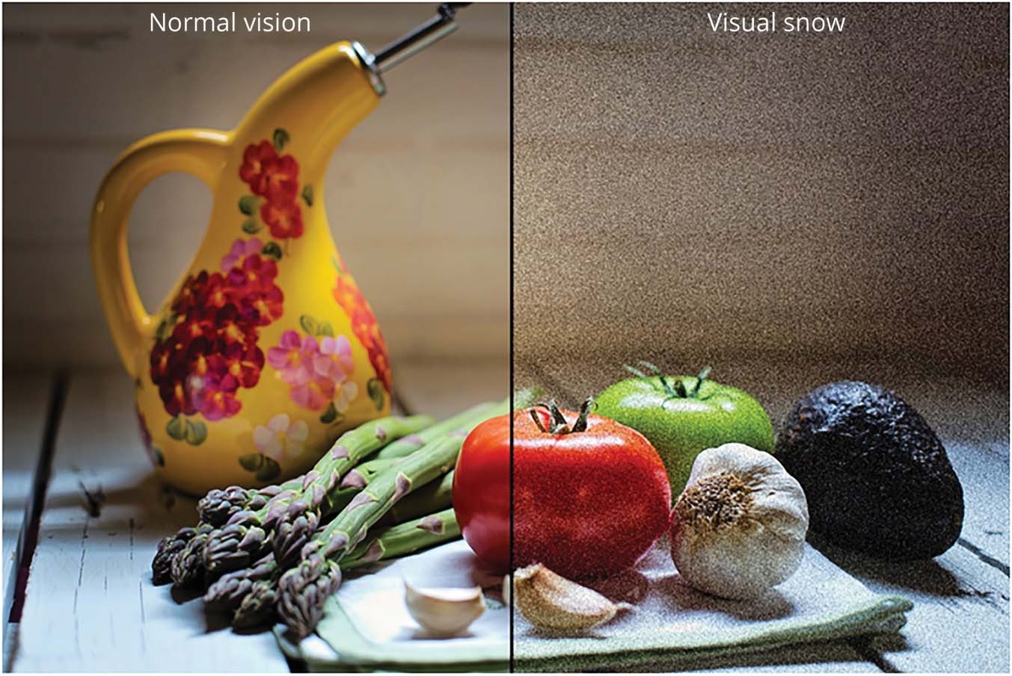
Visual Snow Syndrome
Sophia M. Chung, M.D.
Depts. of Ophthalmology & Visual Sciences and Neurology
University of Iowa Hospitals and Clinics
July 2023
Neurology 94(6):e564-574, 2020
Notes:
Professor Ophthalmology & Neurology
Exclusively practice Neuro-ophthalmology x 31 yrs
I will be speaking on the subject of visual snow which most of us have never heard of but some may know of someone who has it, you may even have it but didn't want to discuss it, but hopefully you will be more knowledgeable when someone walks into your practice

Slide 2
Financial Disclosures
No relevant disclosures

Slide 3
Case presentation
14 yo WF
Cc: “pixelated” vision
  TV static in her entire visual field
  24/7
  Afterimages
  Photophobia
PMH
  Migraine headaches
Notes:
Evrielle smith MRN 14855564

Slide 4
Case
Va 20/20 OU
Pupils normal, no APD
Ext’l/SLE normal
Motility normal, ortho
HVF normal
IOP normal
Fundi normal

Slide 5

Case
Cc: “Pixelated” vision, TV static
Dx?
Work-up?
Treatment?

Slide 6
DDX: Spots & Dots
Diagnosis – benign vs not-so-benign
  Benign
    Vivid imagination
    Normal entoptic phenomenon
      Vitreous floaters
      Purkinje tree
      Blue field phenomenon
Notes:
Before we talk about this patient’s specific diagnosis, it’s important to understand there is a differential diagnosis and a variety of things that can cause spots and dots, some benign and some not so benign
Entoptic : images that arise from within the eye such as vitreous floaters or the retinal circulation that casts a shadow onto the photoreceptors.
Blue Field Phenomenon is

Slide 7
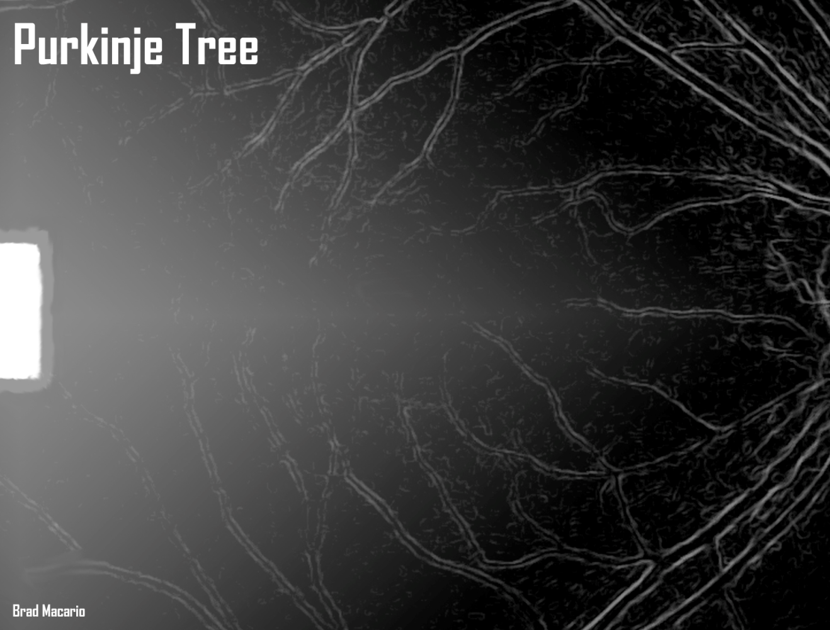
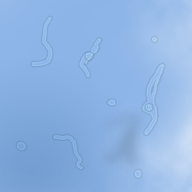
Entoptic phenomenon
Visualize an internal structure in the eye
Examples
  Floaters
    Vitreous strands
    Hemorrhage

Slide 8

Blue Field Entoptic Phenomenon
Scheerer’s phenomenon
Blue sky sprites
By Unmismoobjetivo - Own work, CC BY-SA 3.0,
https://commons.wikimedia.org/w/index.php?curid=27269687
Notes:
White cells don’t absorb blue light
Red cells do absorb blue light

Slide 9
Blue Field Entoptic Phenomenon
Notes:
The white cells are larger than the red cells and they nearly fill the capillary .
White cells and the space in front of the white cells allows the blue light to pass through but the red cells bunch up and cause a dark streak behind it.

Slide 10
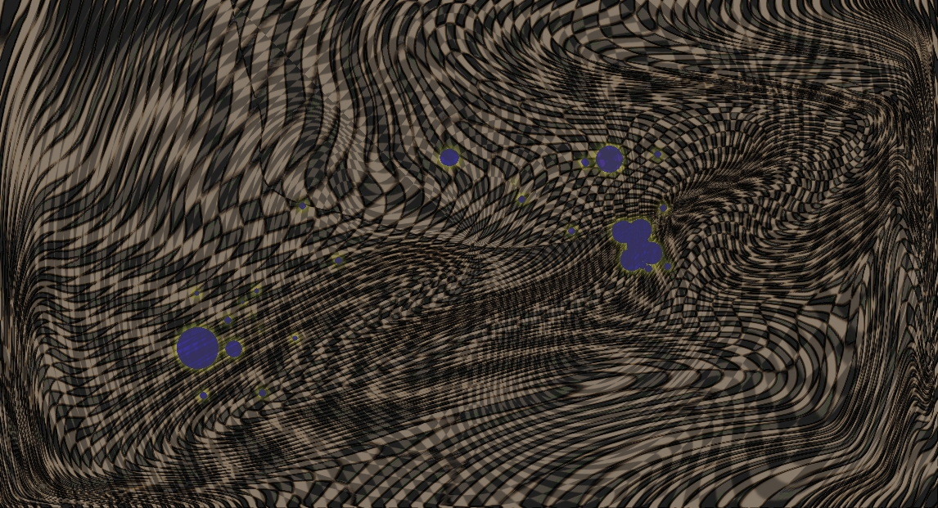
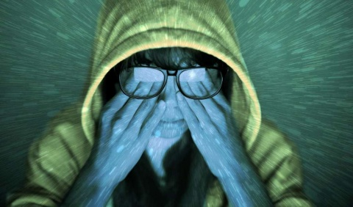
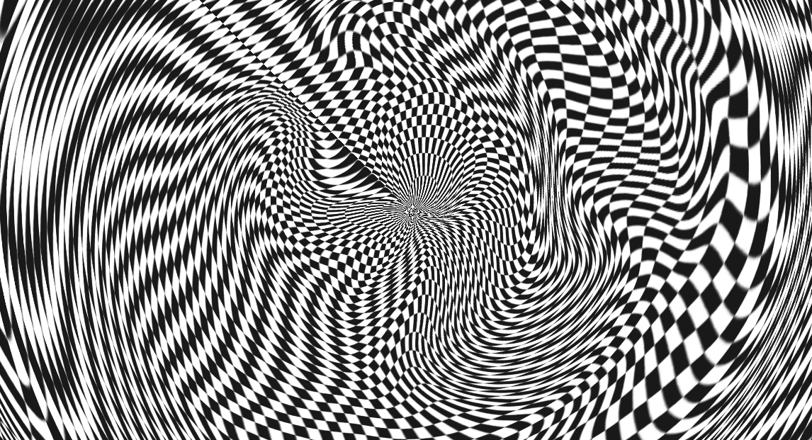
Entopic Phenomenon: Phosphenes
Phosphenes
  Perception of light w/o light stimulus
  Mechanical stimulation of the retina
    Eye rubbing
    Valsalva
Dukeeyecenter.duke.edu
Berkeleysciencereview.org
Notes:
PHosphen

Slide 11
DDX: Spots & Dots
Diagnosis – not-so-benign
  Migraine
  Occipital lobe epilepsy/lesion
  Paraneoplastic/autoimmune retinopathy
  White dot syndromes

Slide 12
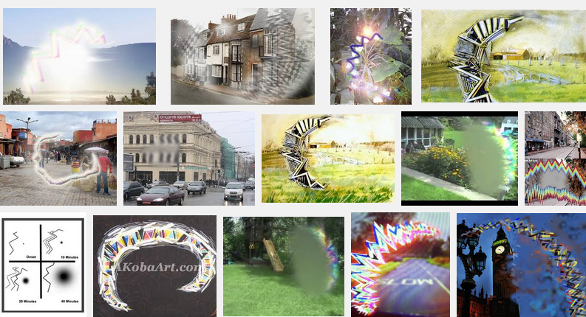
Migraine Visual Aura
Notes:
Visual aura that typically lasts 15-30 minutes, can manifest as small bright lights, blind spots, static/foggy vision, or a crescent-shaped scintillating scotoma that expands and is surrounds by flashes of light or zigzags. It can enlarge, migrate

Slide 13
Migraine Visual Aura
Migrainebuddy.com

Slide 14
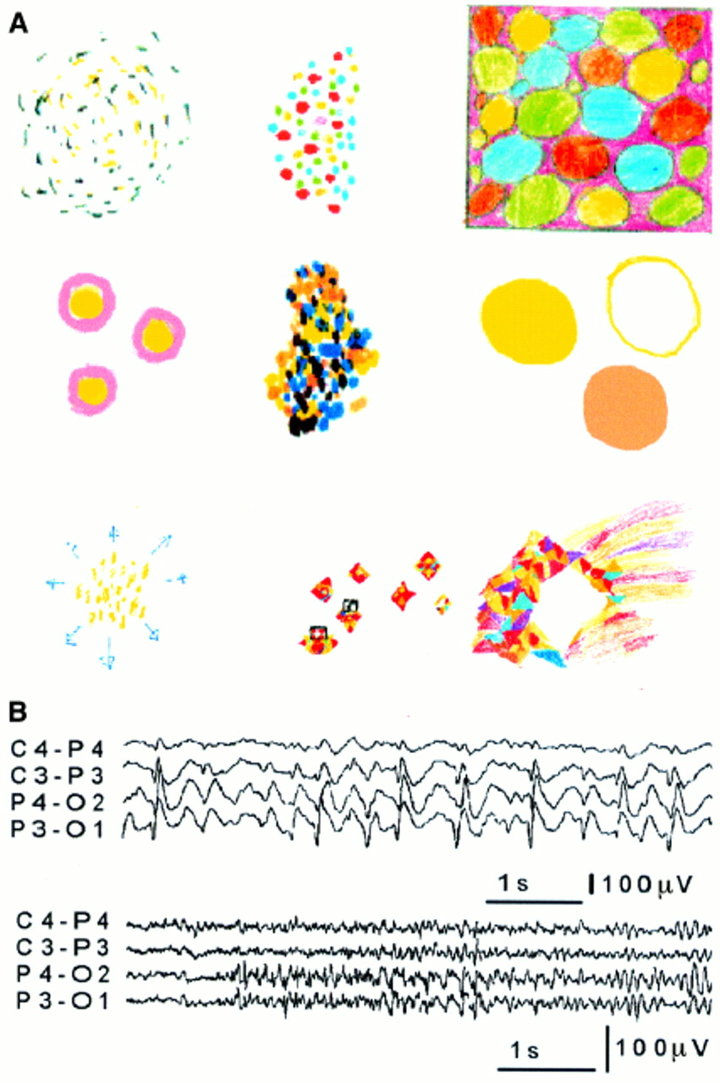
Occipital lobe epilepsy/lesion
C P Panayiotopoulos J Neurol Neurosurg Psychiatry 1999;66:536-540
Notes:
Multiple bright colored small spots, circles, balls, (but can be triangles, rectangles) flashing, can multiply and increased in size; may progress and spread to other parts of the brain; the images can spin, rotate; most last 5-30 sec although they can last minutes; can be daily, diurnal ; often no precipitating factors but could be from exercise, hunger, darkness, non-flickering lights, xs alcohol
(A) Elementary visual hallucinations as perceived and drawn by eight of the nine patients with IOEVH. First and second row from left to right: the illustrations of patients 1 to 6 are consecutively presented. Third row from left to right: the illustrations of patient 7 (left) and 8 at onset (middle) and just before progressing to loss of consciousness and GTCS (right). (B) From video-EEG recordings. First row: high amplitude occipital paroxysms from video-EEG of patient 3. They were immediately activated by closing the eyes and persisted as long as the eyes were closed. Opening the eyes immediately eliminated the occipital paroxysms for as long as the eyes were opened. The occipital paroxysms were similarly activated in conditions of elimination of fixation and central vision (darkness, vision through goggles covered with semitransparent tape) and inhibited in conditions that these were preserved (fixation off sensitivity). Second row: low amplitude, occipital fast rhythms intermixed with spikes from video-EEG of patient 6. These occurred immediately after closing the eyes. They did not persist during the remaining period that the eyes were closed. Contrary to the occipital paroxysms of patient 3, they were eliminated in darkness and the patient also had time locked occipital spikes induced by intermittent photic stimulation.

Slide 15
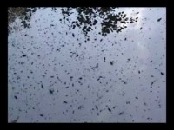
Paraneoplastic/AI retinopathy
https://www.youtube.com/watch?v=NOGzPYUs910

Slide 16
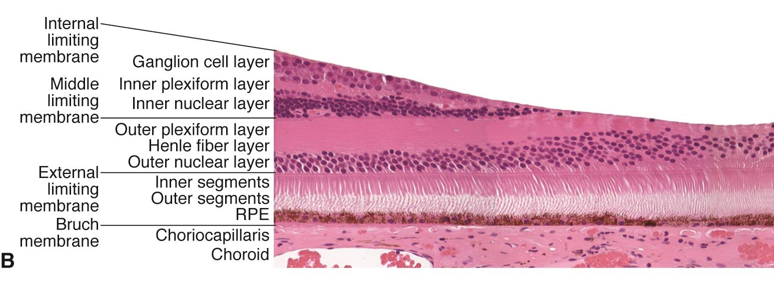
Paraneoplastic retinopathy: e.g., cancer associated retinopathy
Bmcophthalmol.biomedcentral.com
Adapted from www.octscans.com
Aao.org

Slide 17
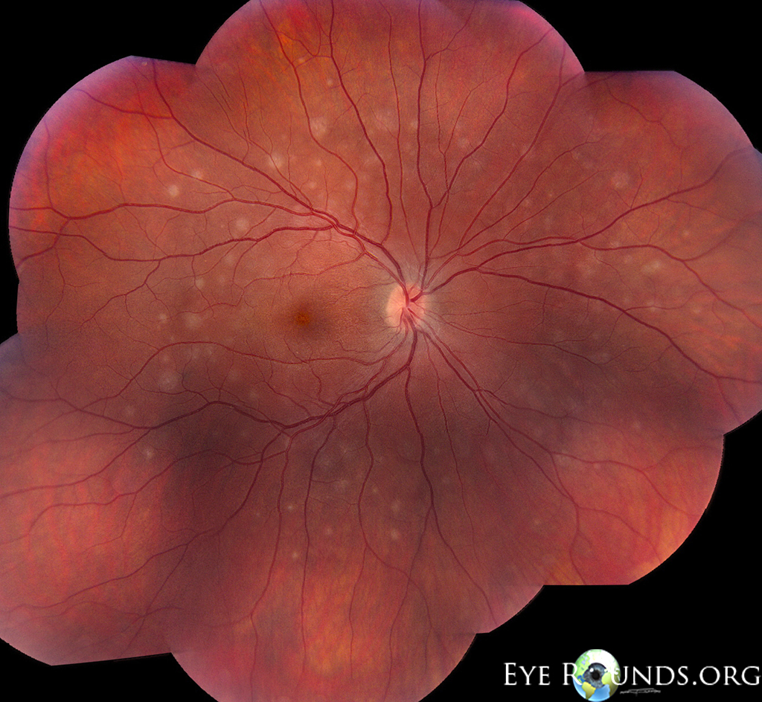
White Dot Syndromes e.g., multiple evanescent white dot syndrome
Photopsias

Slide 18

Visual Snow: Aeropsia
TV static
Constant 24/7
Flickering dots/lights
Superimposed on
environment
Twietter.com

Slide 19
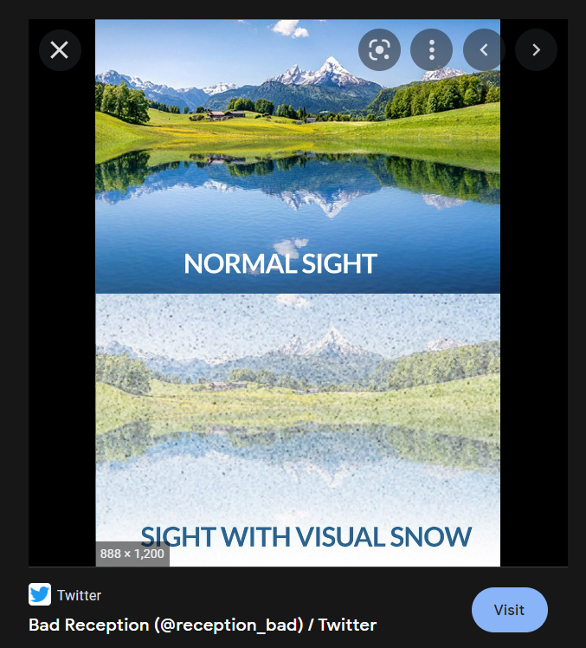
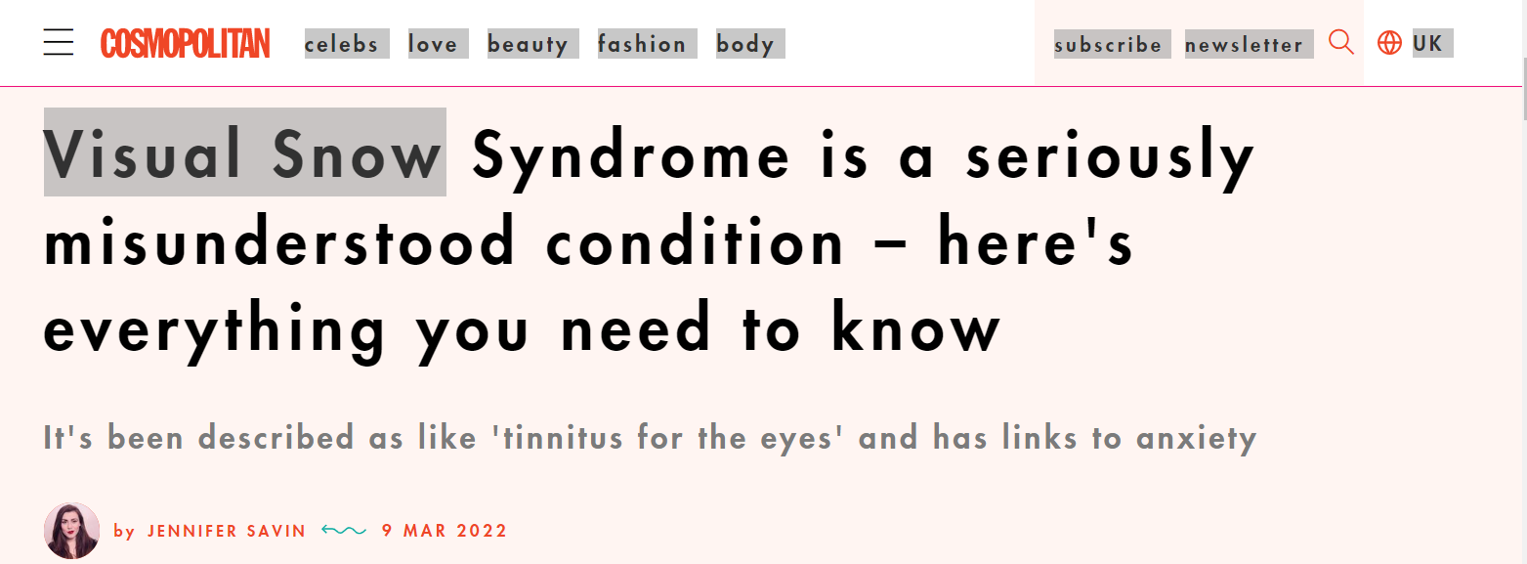
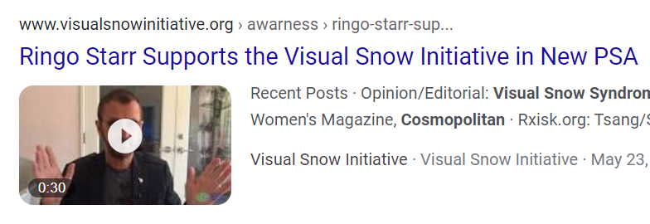
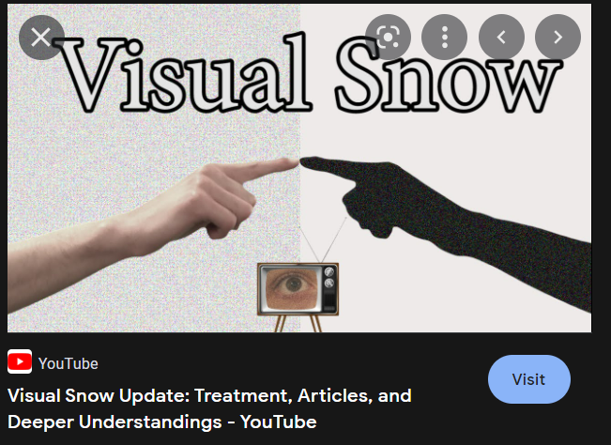

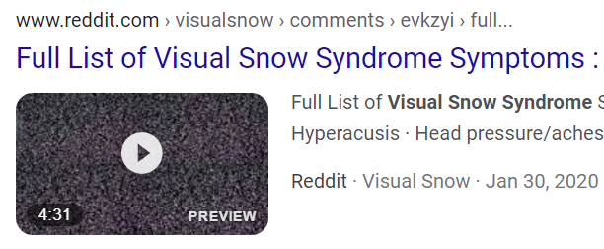
Visual Snow: Who Knows About It?
Notes:
Who knows about visual snow? Well, everyone except physicians apparently. Twitter, Youtube, Reddit, Pinterest, even Ringo Starr and Cosmo magazine. As a result of this explosion of info, we are now getting 1-2 pts a week, people emailing us, and we need to know about this entity.

Slide 20

Visual Snow
By Kaidor - Own work based on File:Cielo_(300968795).jpg, CC BY-SA 4.0, https://commons.wikimedia.org/w/index.php?curid=62206924
Notes:
Typically black and white

Slide 21
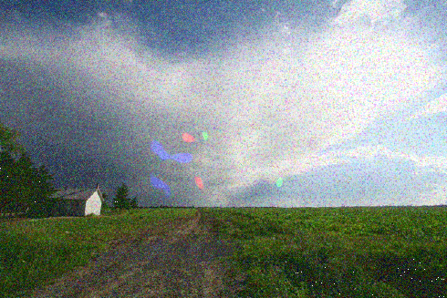
Visual Snow
www.migraine-aura.com
Notes:
But sometimes has color, and can have superimposed visual imagery

Slide 22
Visual Snow
http://www.visionsimulations.com/

Slide 23
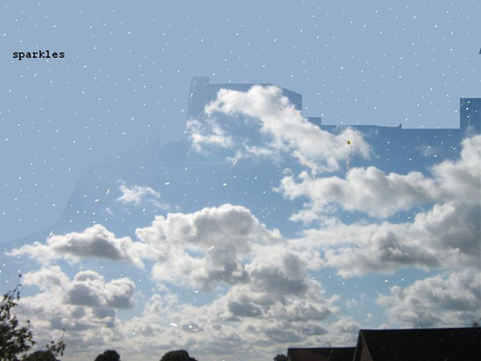
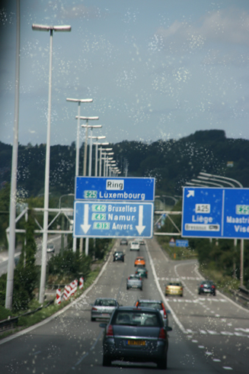
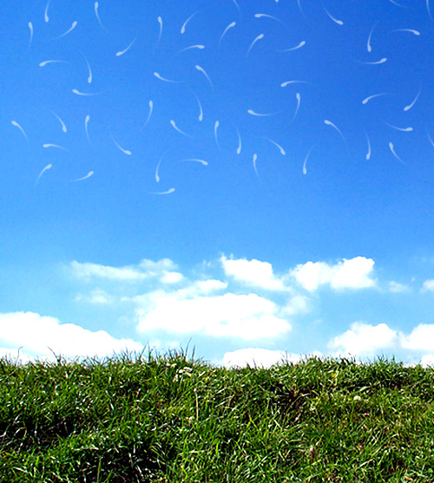
www.migraine-aura.org

Slide 24
Symptoms of Visual Snow
  A million dots
  Black cracks and lines
  Blobs of white and gray
  Blue squares
  Carpet background
  Circles
  Clouds
  Comets
  Dots, b/w & colored
  Grainy vision
  Heat waves
  Lights, flash/flicker
  Lines of ants
  Photopsias
  Rain-like pattern
  Snow
  Squiggles
  TV static
Liu et al, Neurology 45:664-668, 1995
Notes:
Simple unformed

Slide 25
Visual Snow: many names
Prolonged migraine aura status (Haas 1982)
Sustained visual aura
Persistent positive visual phenomena (1995)
Persistent migraine aura
Migraine aura status
Persistent migrainous visual phenomena
Persistent migraine aura w/o infarction
(IHC 2003)
Primary persistent visual disturbance (2005)
Visual snow (2014)
Notes:
Notice how many of the names include migraine; there is some overlap in the pathophysiology but also distinct differences

Slide 26
Persistent Aura w/o Infarction
Persistent aura without infarction
  Aura symptoms > 1 week w/o infarction
  Rare
  Bilateral
  Lasts months to years
  Most have h/o migraine or variant
Notes:
Definition applied

Slide 27
Primary Persistent Visual Disturbance
Notes:
Dr. Goadsby described 4 patients with visual snow, 3 of whom had migraine but the visual snow was not necessarily related to their headache or migraine so he introduced a new term primary persistent visual disturbance but did acknowledge that the patients called it visual snow.

Slide 28
Visual Snow
Notes:
Largest series with 78 patients with a systemized approach to the patients although it was by survey and phone calls. 92% had at least 3 additional visual sx

Slide 29
Visual Snow Syndrome: Criteria
Dynamic, continuous, flickering tiny dots
Entire visual field
2 of the following 4
  Enhanced entoptic phenomenon
  Photophobia
  Nyctalopia
  Palinopsia
Curr Opin Neurol 2018;31:52-58
Notes:
Goadsby group
Static, pixellation

Slide 30
VSS: Criteria
Entoptic phenomenon
  Floaters 81%
  Blue field entoptic 79%
Photophobia 74%
Nyctalopia 68%
Boldedscience.com
Notes:
But ERGs normal and a hypothesis that the interaction between rods and cones may be abnormal

Slide 31
Palinopsia
Perseveration of visual image
  Stimulus gone
  Different than normal retinal afterimage

Slide 32
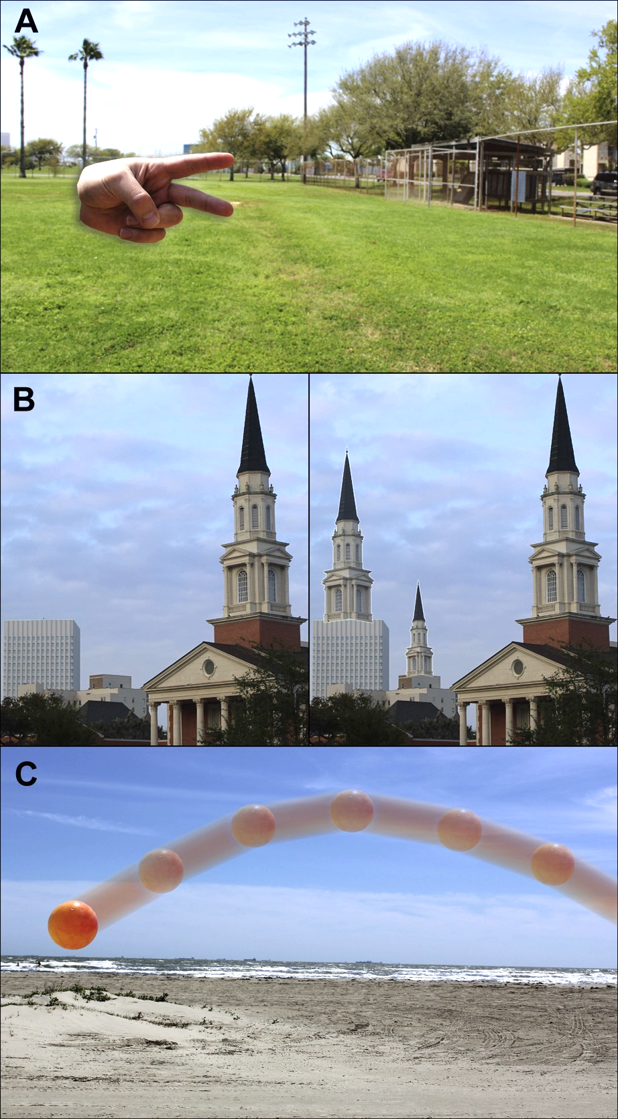
Palinopsia
Palinopsia 69%
  Stationary 86
  Trailing moving objects 60
Surv Ophthalmol 60:1-35, 2015
Notes:
But ERGs normal and a hypothesis that the interaction between rods and cones may be abnormal

Slide 33


VSS: Criteria
Other frequent & persistent visual phenomenon
  Halos
  Metamorphopsia
  Colored clouds
  Water running down a window
Allaboutvision.com
Curr Neurol Neurosci Rep 2018;18:52
Brain 2014;137:1419-1428
Notes:
Metzler suggested modification

Slide 34
VSS

Slide 35
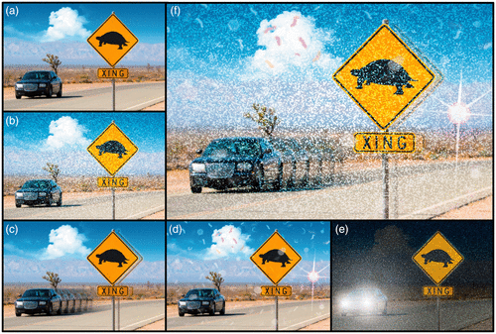
Visual Snow

Slide 36
VSS: Demographics
Web-based survey of 1,104 pts w/VS
Xage 29
M=F
Onset early in life
All of their life 40%

Slide 37
VSS: Comorbidities
Comorbidities
  Migraine 60%
    Often severe migraine triggers
  Tinnitus 62%
  Concentration difficulties 60%
  Anxiety 44%
  Depression 19%
JNO 38(4):514-521, 2018Unit Name Here >> Go to View >> Header/Footer
Notes:
Need to be careful to differentiate from migraine with aura; homonymous pattern,

Slide 38
VSS: Testing normal
Eye and neuro examination
Ancillary testing: VF, OCT, ERG, VEP
MRI
Mistakenly considered psychogenic

Slide 39
VSS: Pathophysiology
Unknown
Bilateral, symmetric, constant, spacing
Cortical
Normal?
  Visual noise?
  Similar to tinnitus?
  Result of abnormal inhibition?
Notes:
Maybe this is actually a normal phenomenon but most people habituate, in other words can turn it off

Slide 40
VSS: Pathophysiology
Spontaneous: majority (57.6%)
Inciting events
  Trauma
  Change in migraine/aura
  Illness
  Hallucinogen persisting perception d/o
  Associated eye ds, e.g., RP, IIH
Cephalalgia 41:1015-1026, 2021
Notes:
Maybe this is actually a normal phenomenon but most people habituate, in other words can turn it off

Slide 41
VSS: Pathophysiology
3 major theories:
  Hyperexcitability
  Hypoconnectivity
  Thalamocortical dysfunction
  Combination of all three

Slide 42
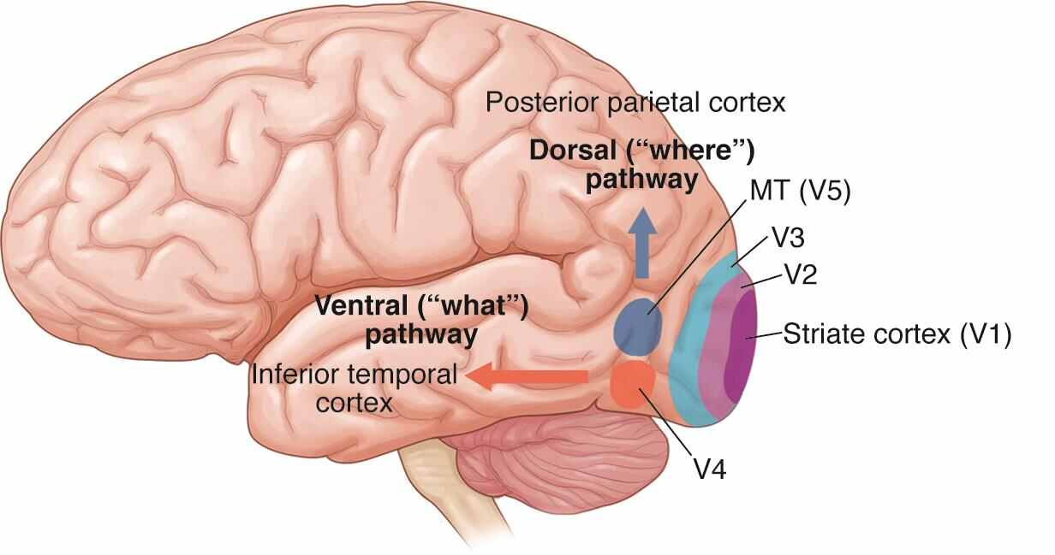
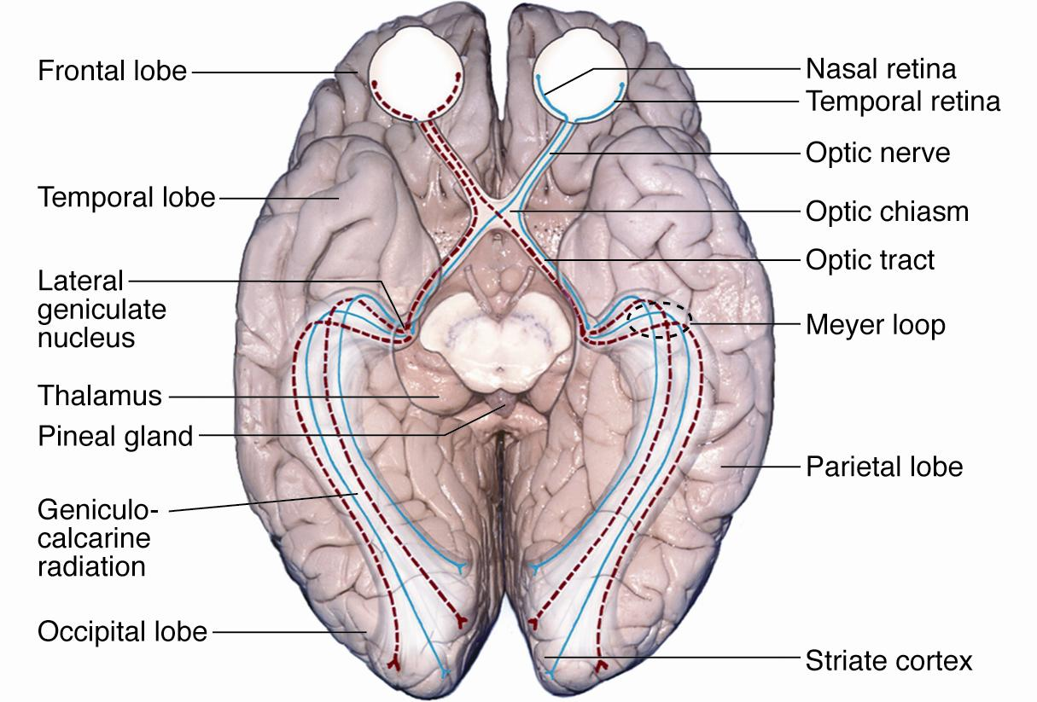
VSS: Pathophysiology
Theories
Supplementary visual cortex
Aao.org
Aao.org
Thalamic dysfunction
Primary visual cortex
Brainmind.org
Notes:
Some experts have suggested Thalamic dysfunction because of the common associated symptom of photophobia
Some have suggested the primary visual cortex but I think this is less likely since the symptoms don’t occur in a homonymous pattern and the examination is otherwise so normal
Many authorities believe the supplementary visual cortex is more likely. Palinopsia traced back to Parietal association cortex. Some studies support hypermetabolism I the lingual gyrus, Brodmann area 19

Slide 43
VSS: Pathophysiology
Cortical hyperexcitability
  Magnetoencephalography
  Functional MRI abnormalities
  Hypermetabolism on PET
  Hypometabolism on SPECT
  Elevated spontaneous neural firing
  Inconsistent studies VEP and EEG
https://brainpainter.csail.mit.edu/
Cephalalgia 2020;41:1671-1675
Neurology 2018; 88:1243-49
Brain. 2011;134:2387-2395
Headache 2014;54:957-66
Headache 2015;55(10):1436-41
Notes:
Functional brain MRI suggests hypermetabolism right lingual gyrus: 17 pts; dysfunction
Lingual gyrus: visual memory, facial recognition, attention, visual post-processing; lingual gyrus also involved in the perception of photophobia during migraine and larger cortical thickness in migraineurs with photophobia
Normally these flickers are subthreshold
Palinopsia: lack of inhibition of the extra visual stimuli , activation of superior frontal cortex, basal ganglia, occipital lobe; maybe it’s the inability to buffer this system
Headache 2014: Functional brain MRI suggests hypermetabolism right lingual gyrus: 17 pts; dysfunction
Lingual gyrus: visual memory, facial recognition, attention, visual post-processing, photophobia
Normally these flickers are subthreshold
Palinopsia: lack of inhibition of the extra visual stimuli , activation of superior frontal cortex, basal ganglia, occipital lobe; maybe it’s the inability to buffer this system
Last ref: lack of habituation and increased phosphene thresholds
Hypermetabolism on PET of the right lingual gyrus; morphometric studies demonstrate increase gray matter of the right lingual gyrus and
Increased lactate levels in the right ingual gyrus

Slide 44
VSS: Pathophysiology
Neurology 95(13):e1792-31799, 2020
Notes:
Increased gray matter in primary visual cortex, V5 which is thought to control motion and in the cerebellum but why it was lateralized is unclear. Unclear if this is the chicken or the egg

Slide 45
VSS: Pathophysiology
fMRI connectivity whole brain map (BOLD)
Hyperactive neural connectivity
  e.g., V1 to V5, pulvinar to lingual gyrus
Hypoactive
  e.g., salience network
  Resulting in awareness of stimuli that most would consider irrelevant
Hum Brain Mapp.2021;42:2032–2044
Notes:
Salience network described in 2007: regions of the brain that select what stimuli deserve our attention. Insular cortex, anterior cingulate cortex, ventral striatum
BOLD: blood oxygen level dependent responses/scanning to understand connectivity
The second accepted theory is that it’s a neural integration abnormality between multiple sections of the brain
This paper was done by puledda, schankin, and goadsby which showed both hyper and hypoconnectivity . Results support widespread connectivity disturbances

Slide 46
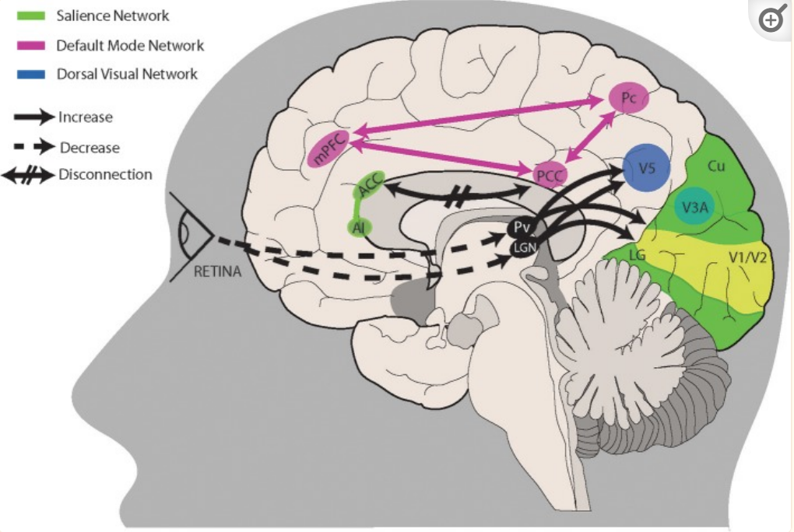
VSS: Pathophysiology
Front Neurol. 2019; 10: 1325
Notes:
Combination of dysfunction in multiple networks
ACC: anterior cingulate cortex
AI: anterior insular

Slide 47
VSS: Treatment
Review of the literature
Prog Brain Res 2020;255:311-316
Notes:
Lamotrigine 100 mg 2x day, partial remission in 20%; blocks voltage-sensitive sodium channels and downregulates glutamate
Then diamox
Side effects in 505
Only 4/26 actually cont’d treatment

Slide 48
VSS: Treatment
Reassurance and validation
Colored filters (blue 80% pts)
Education
  Visionsimulations.com
  Visualsnowinitiative.org
  Wikipedia.com
  Eyeonvision.org
Notes:
Blue yellow signals may counteract thalamocortical hyper-excitability

Slide 49
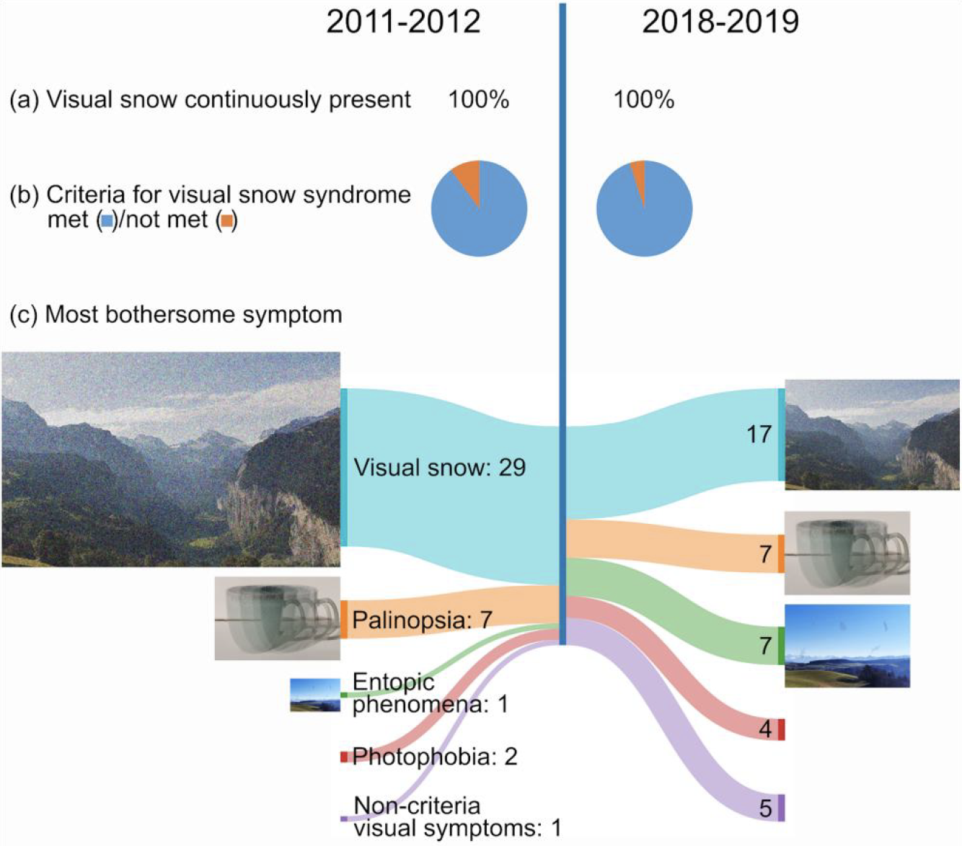
Prognosis
Brain Communications 2022; https://doi.org/10.1093/braincomms/fcac230

Slide 50
VSS: Over the years experience
100 patients over 30 years
Patients wide age range, most 20-30 yrs
Highly observant, articulate
Symptoms stereotypical
Examinations normal
Treatments unsuccessful
Tale of a neurologist

Slide 51
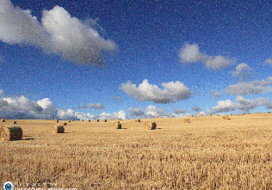
VSS: Conclusions
Visual snow: it’s real
History is key, exam normal
Reassurance
Education
padersophia.Worldpress.com

Slide 52
VSS: Conclusions
Criteria
  Bilateral constant flickering tiny dots
  2 of the following 4
    Palinopsia
    Enhanced entoptic phenomenon
    Photophobia
    Nyctalopia
padersophia.Worldpress.com

Slide 53
VSS: Conclusions
DDX
Treatment
  Reassurance
  Education
    Visualsnowinitiatives.org
    Visionsimulations.com
    Eyeonvision.org
Benign | Not-so-benign
Entoptic Phenomenon | Migraine
Phosphenes | Seizure
 | Paraneoplastic/AIR
 | White dot syndrome

