Slide 1


GLOBAL OPHTHALMOLOGY
Grace Sun, MD
Associate Professor in Ophthalmology
New York Presbyterian Hospital/Weill Cornell Medical College
President, Women in Ophthalmology

Slide 2
“SOPO”
Notes:
And this is where I’m from… the great city of New York-- OK…
What does this have to do with global health!
The date was oct 28th 2012… and Hurricane Sandy, the worst storm in decades was bearing down on New York (as well as other cities)
and this… is what a map of how it affected us.
This area.. was now dubbed “SoPo” or south of power… and this is where I live…and work, and the rest up of the week up here.
Rode the bus downtown… and I crossed this line– and IT WAS DARK… except for the lights in the bus, and I was one of those without.
no electricity, no running water, ( I felt like I was back in Nicaragua where I was a Peace Corps volunteer!!
Here in NYC, people were searching for places to eat, shower, plug in their cell phones for a connection to the world…
Now really, what does this have to do with GLOBAL Health?
- Let’s look at another map…

Slide 3
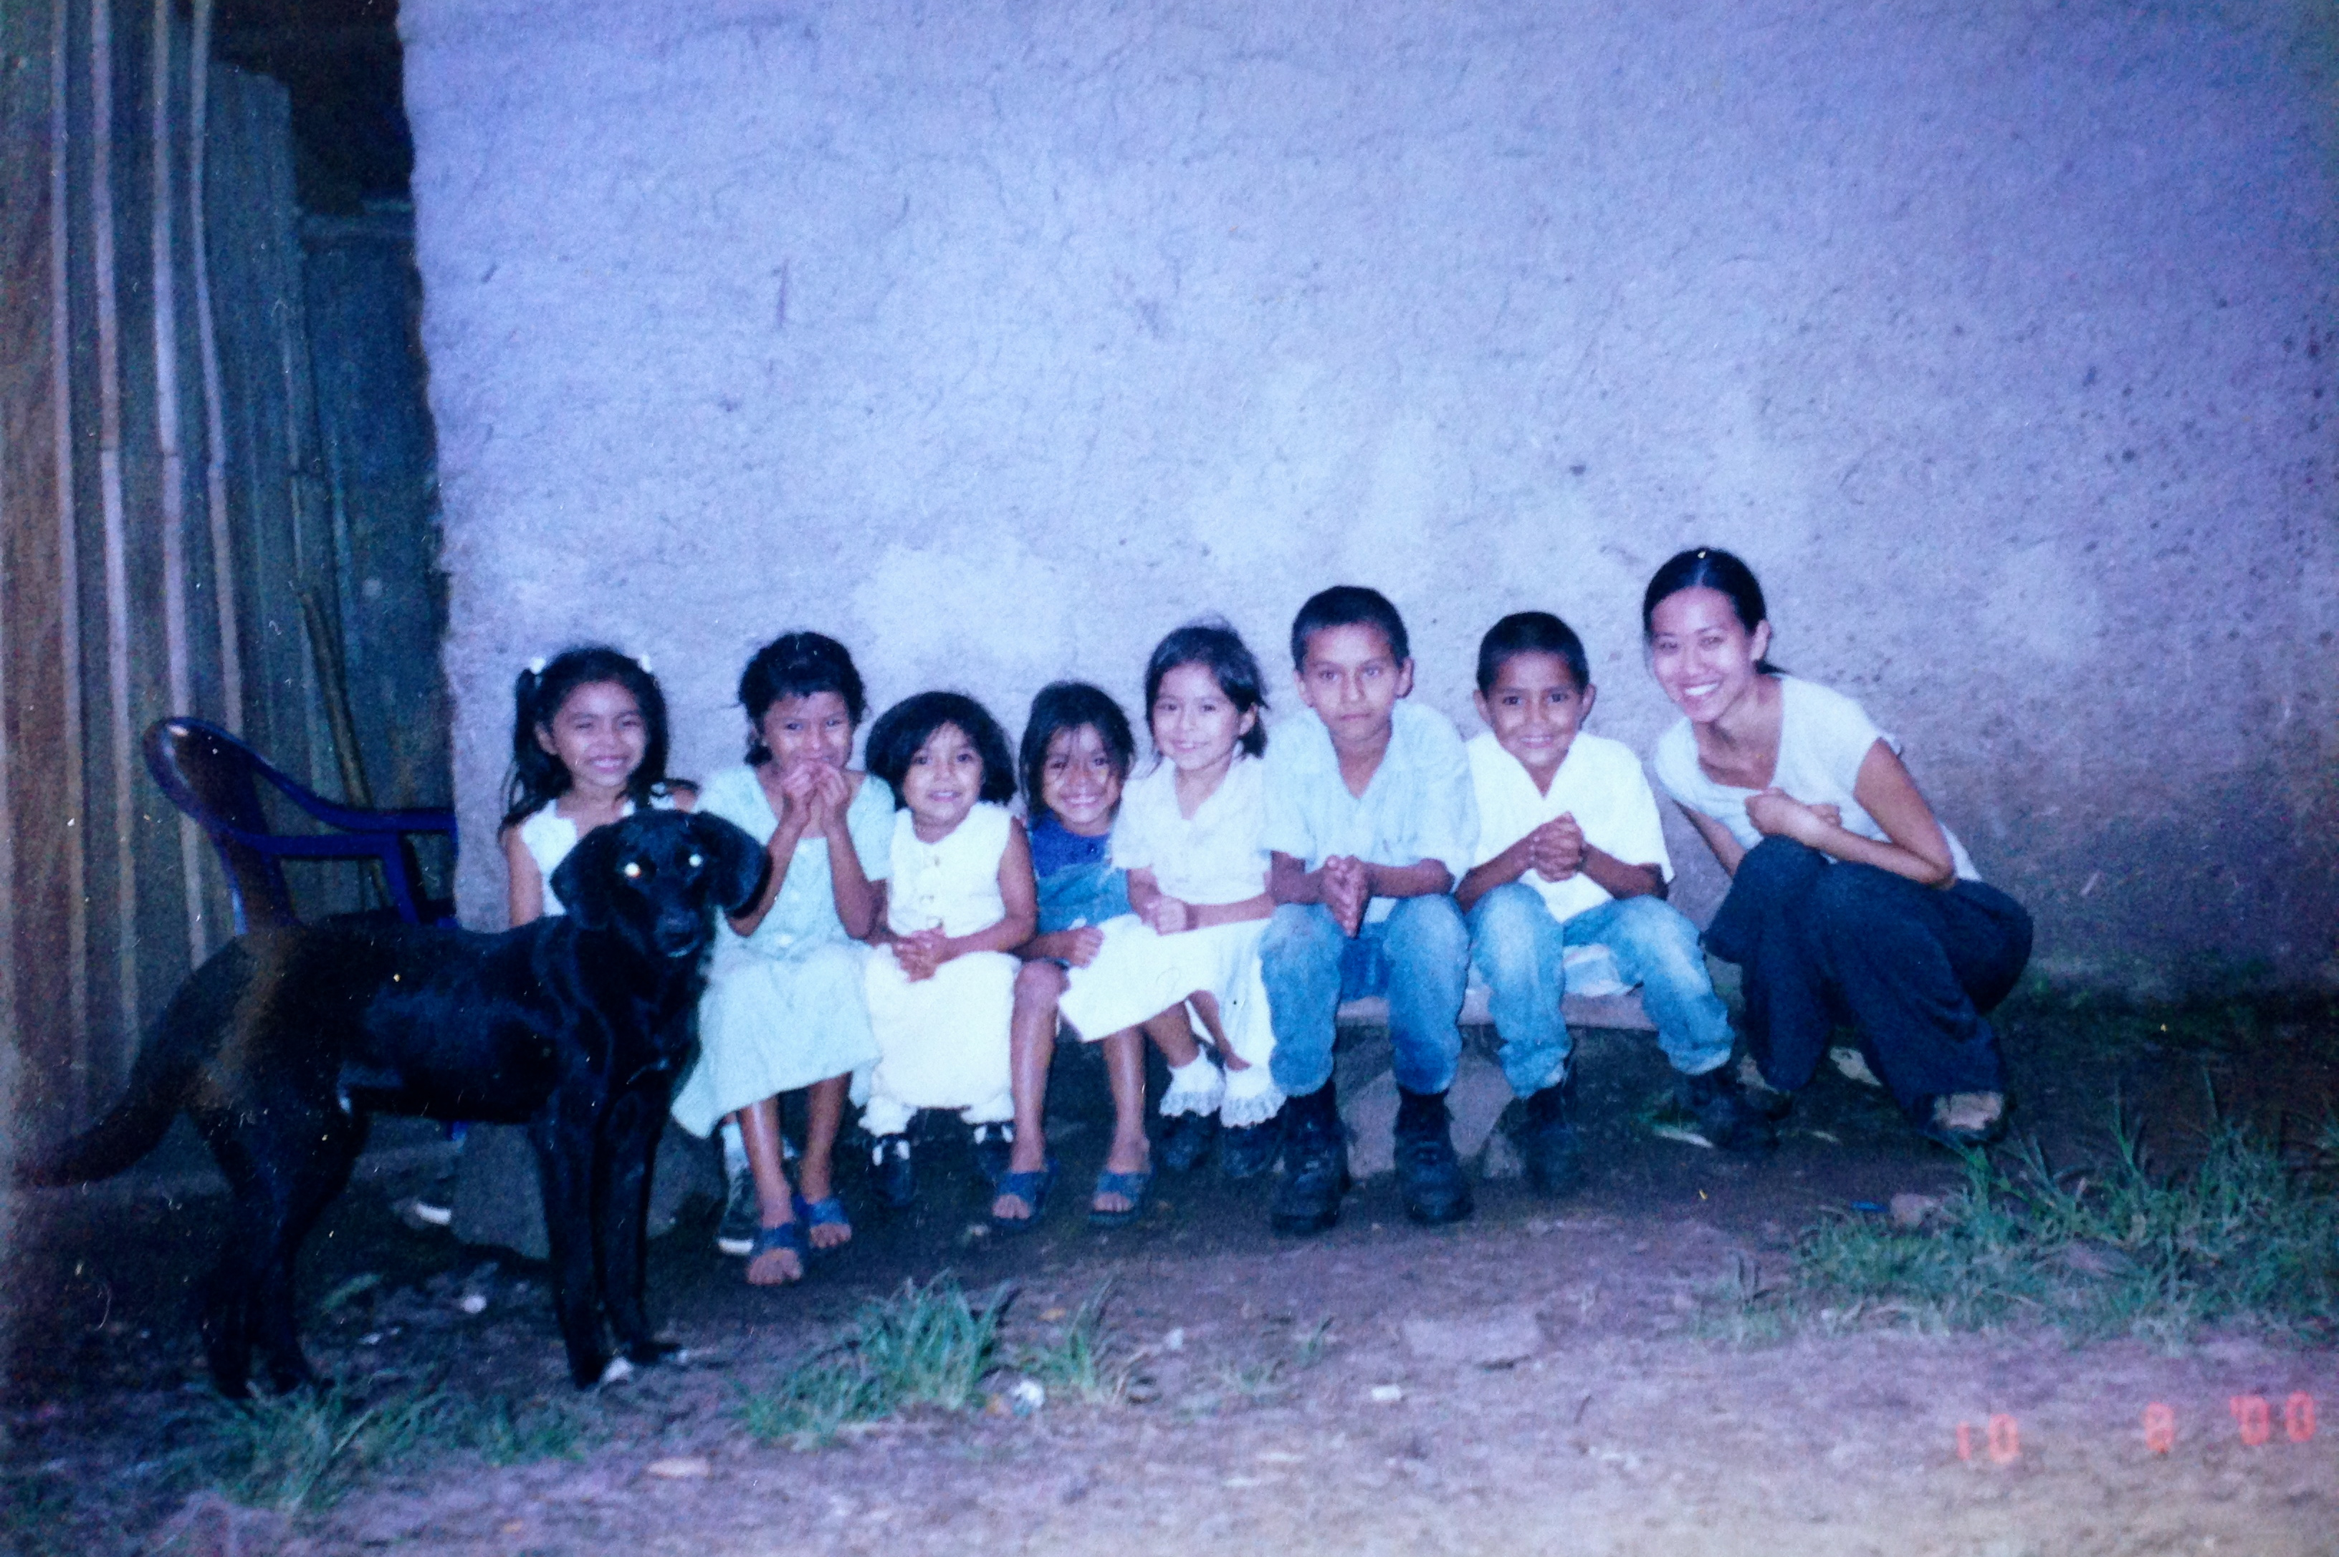
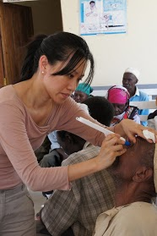


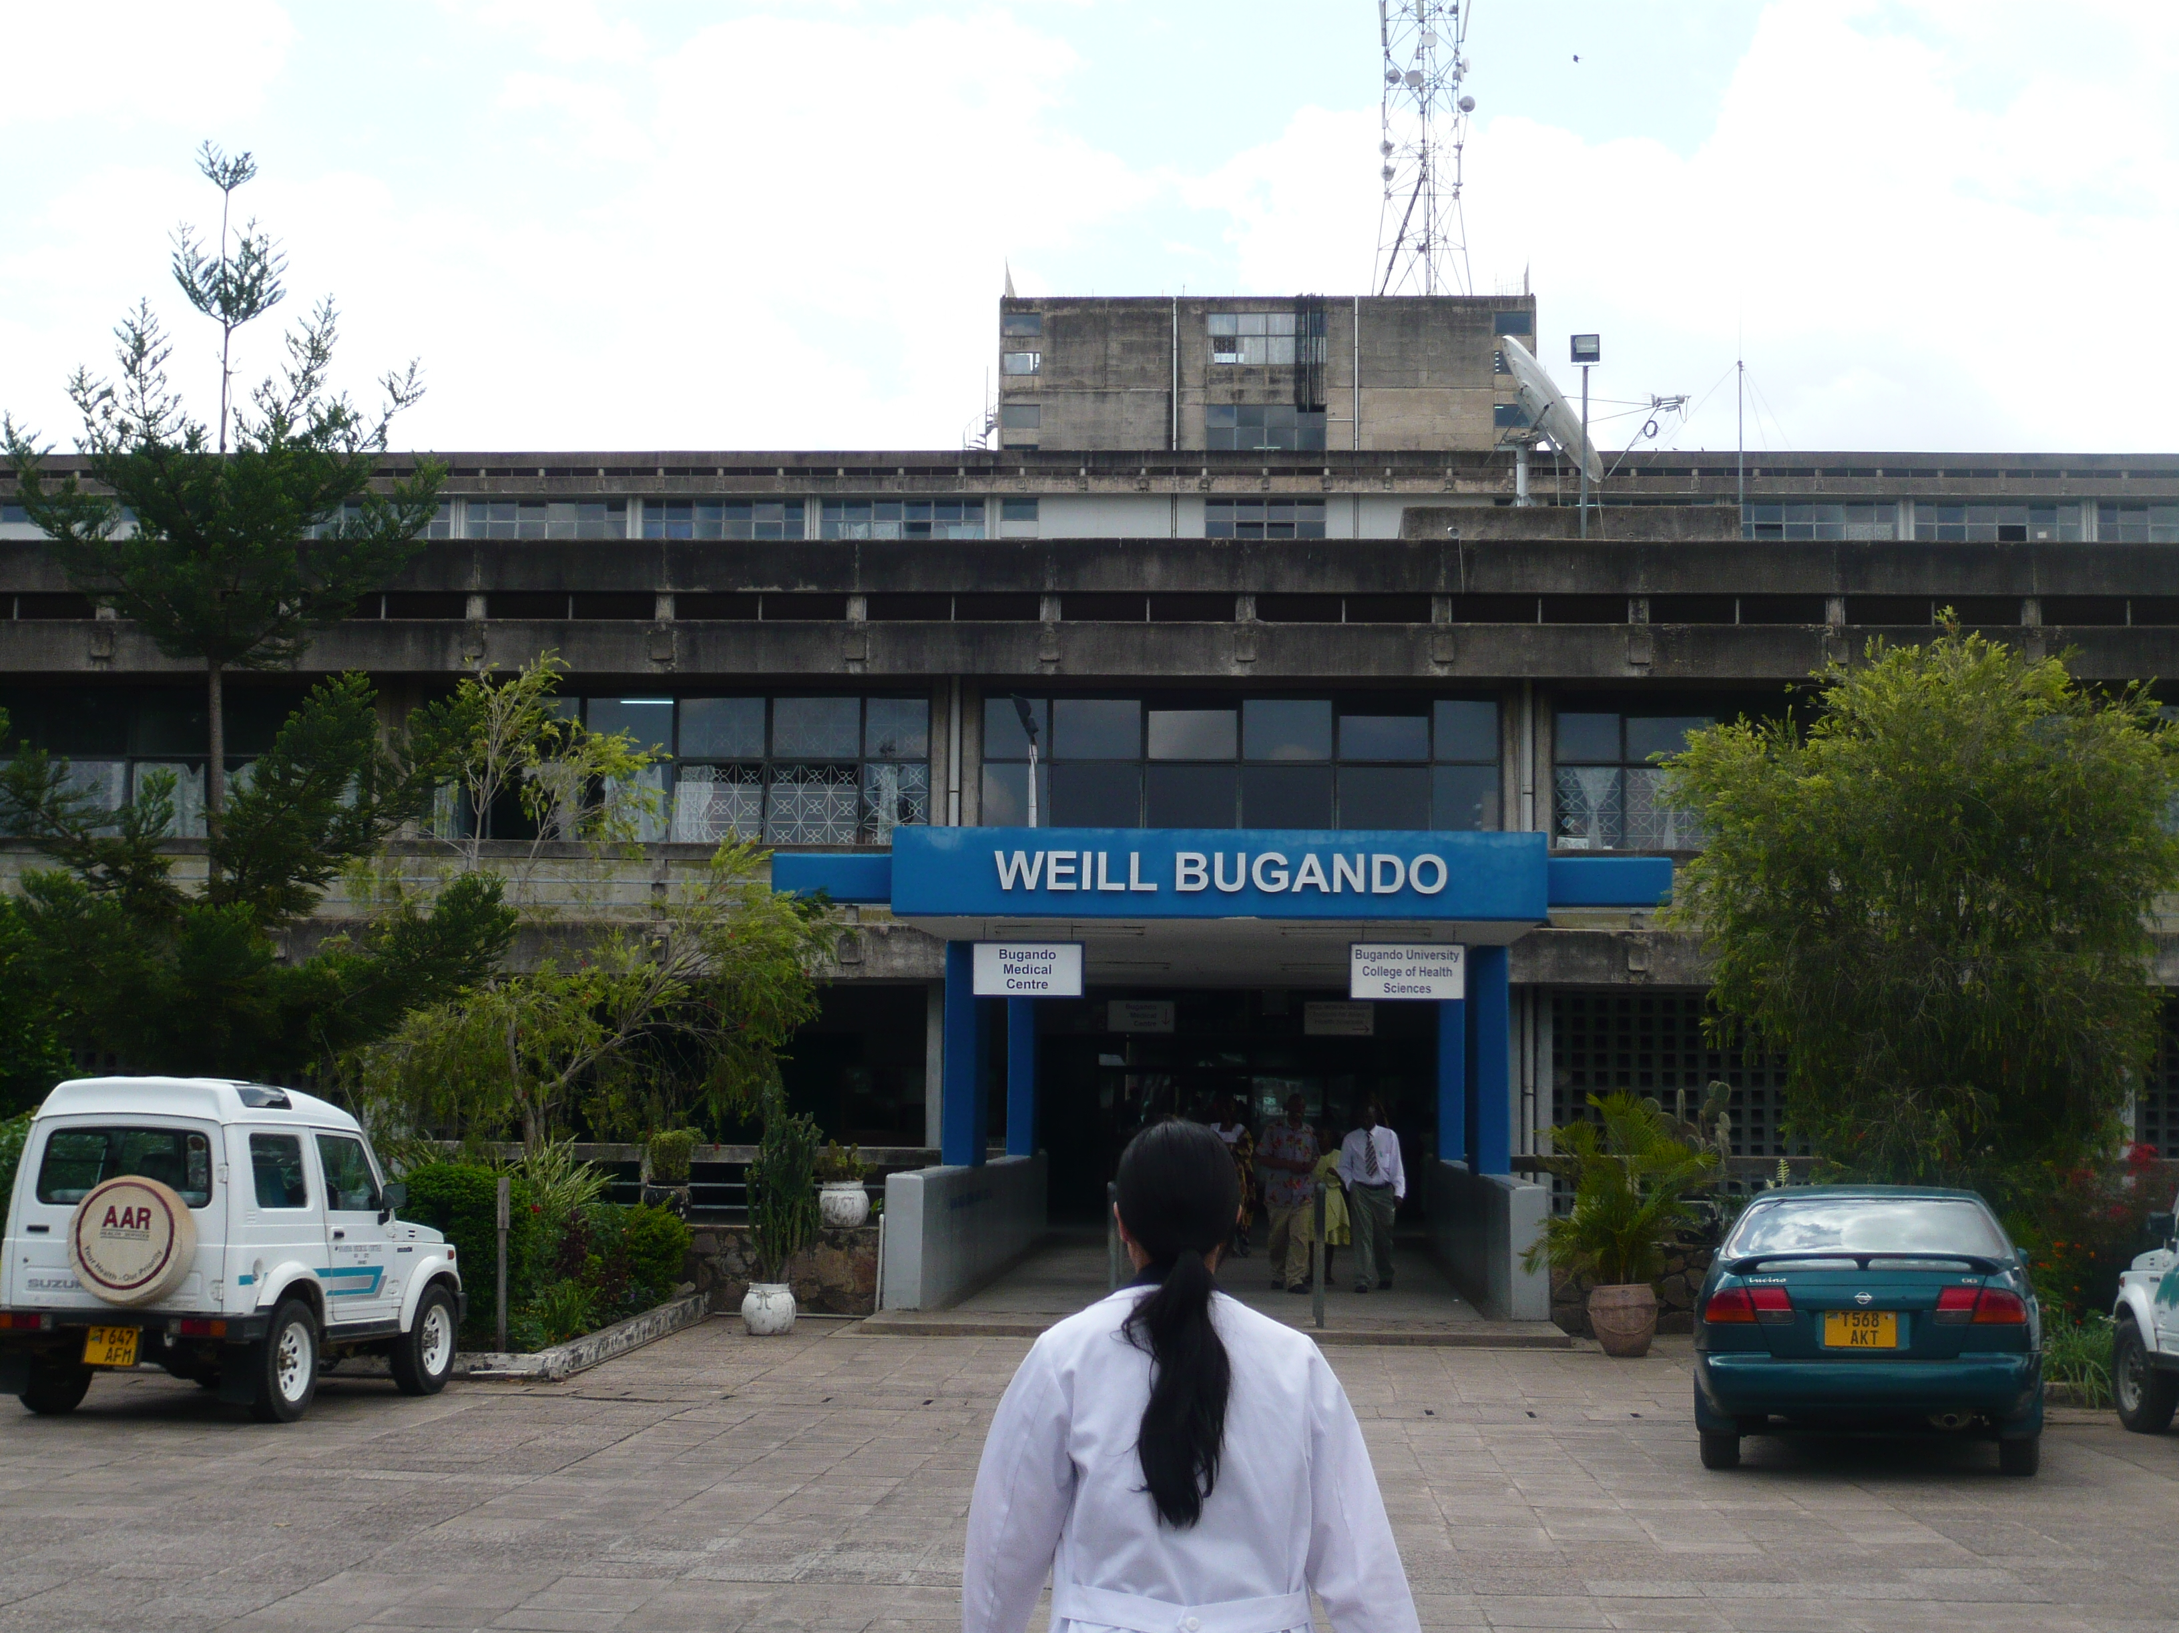
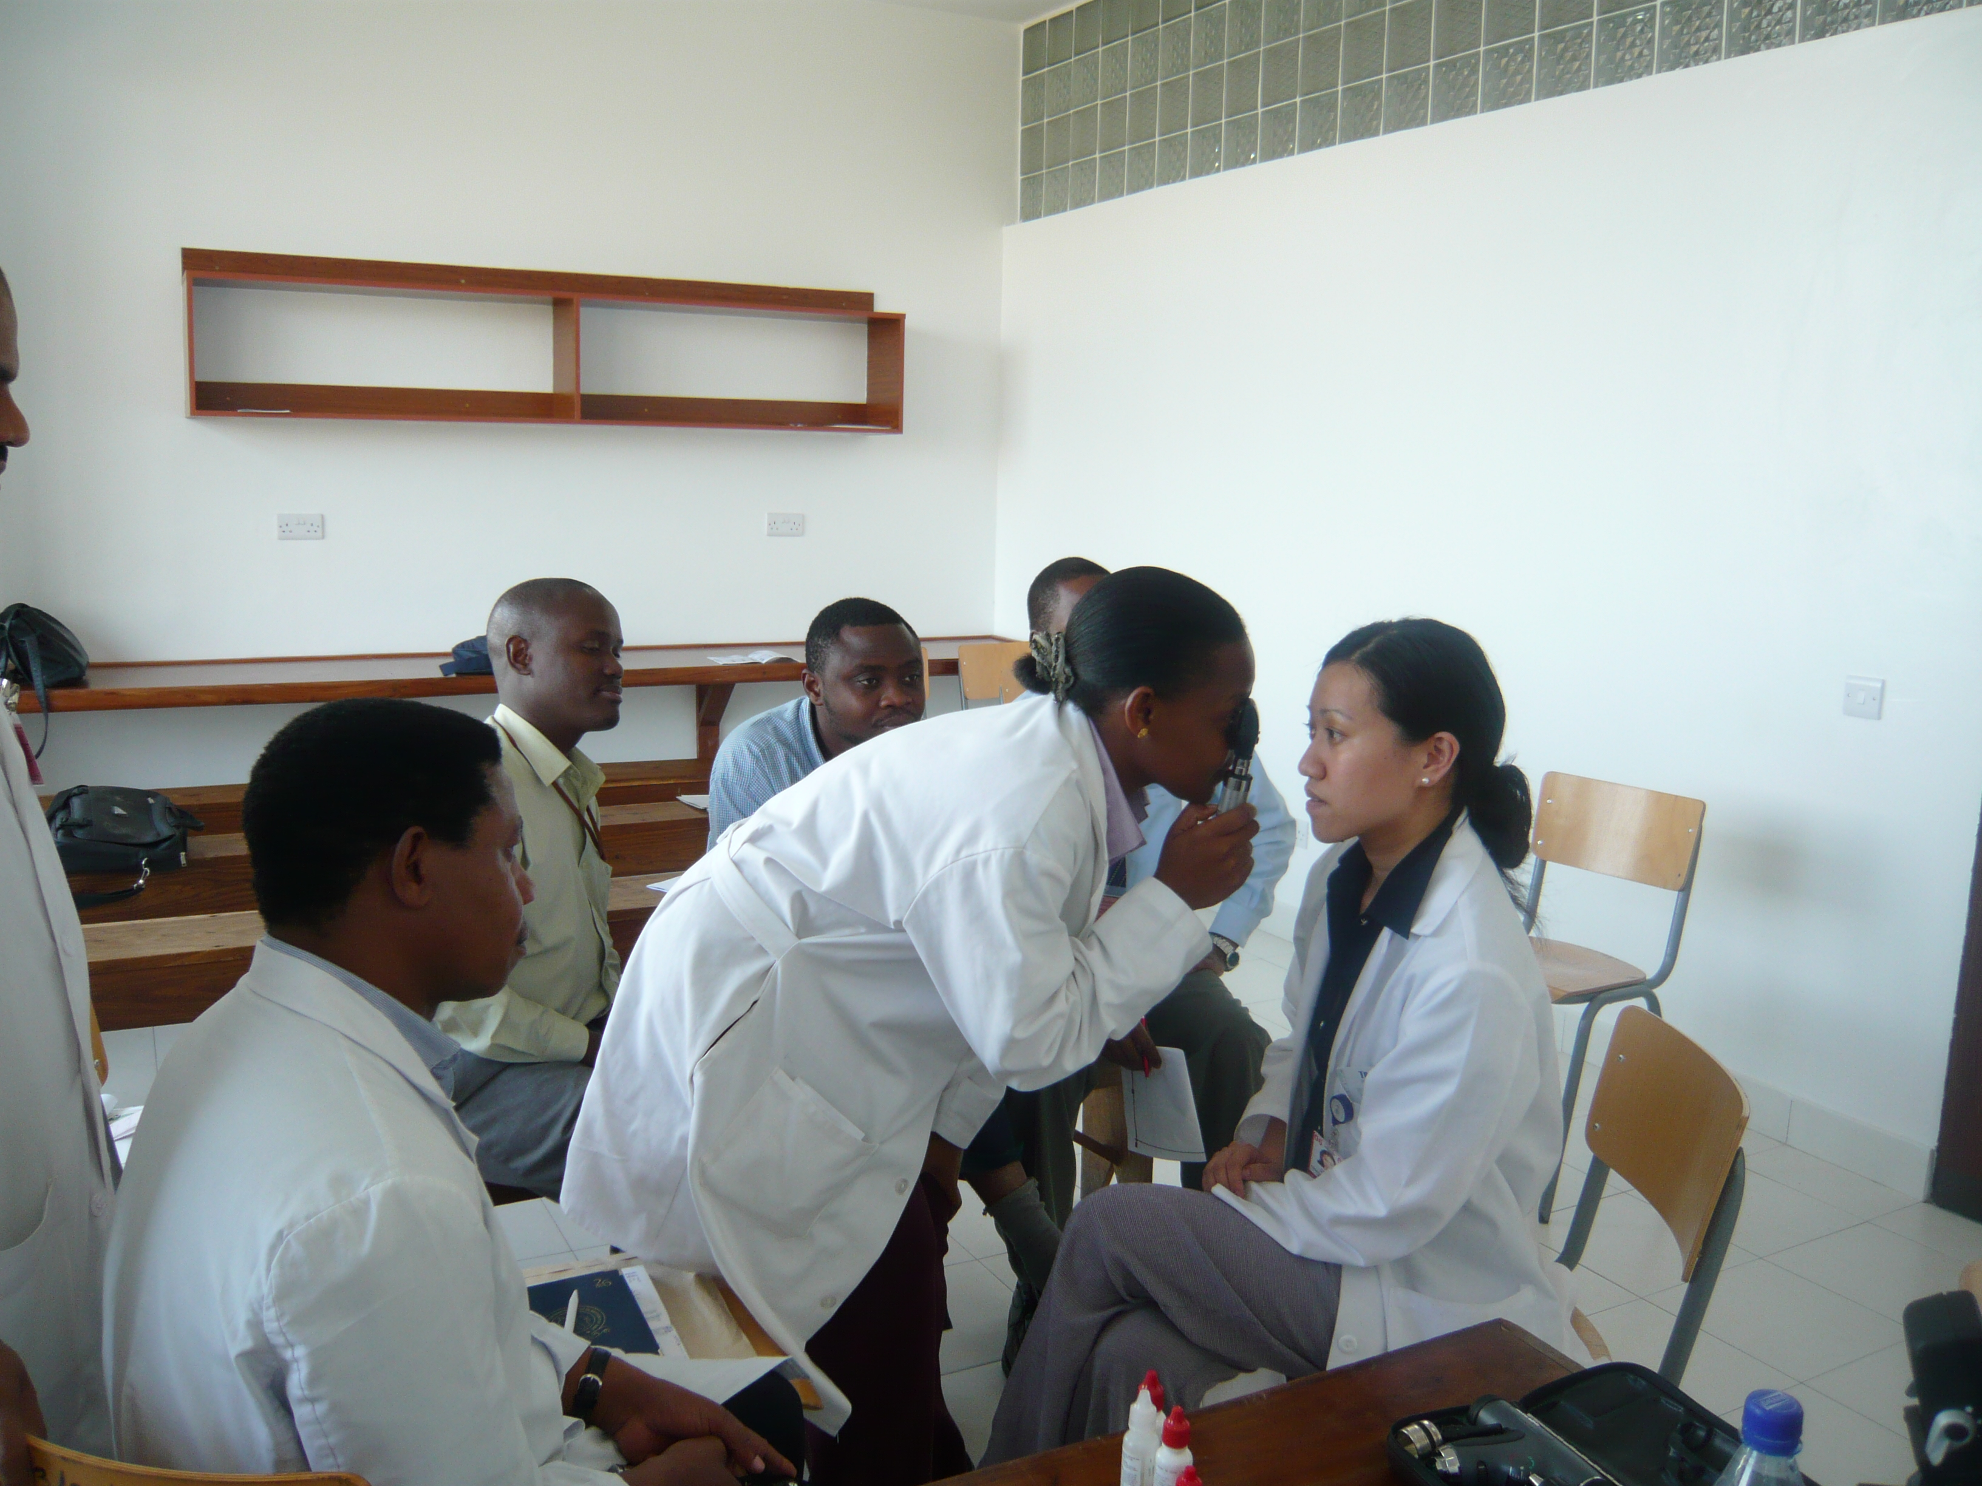
here’s my story…
Notes:
Here’s my story… WHO→medicine→ ophtho
NICA- really dark and skinny– diet of gallo pinto– rice and beans
PCV- med school- residency- faculty
that’s a little about me and where I’ve been

Slide 4
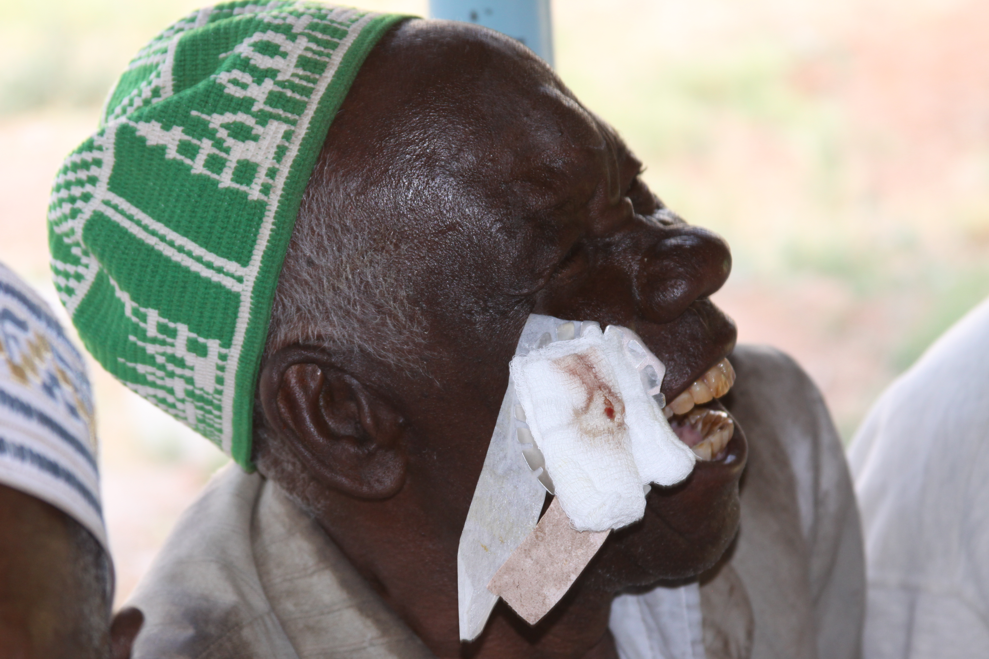
The definition of global health has evolved.
“Global health is an area for study, research, and practice that places a priority on improving health and achieving equity in health for all people worldwide.”
Koplan, et.al. Towards a common definition of global health. Lancet 2009; 373: 1993–95)
Notes:
As our world becomes more interconnected and interdependent, we have expanded what “global health means”
ophtho: cataracts, refractive error, disparities in access to care, human resources, global health work-
SERVICE DELIVERY- individual surgeries
CAPACITY BUILDING: , education (telemedicine), lectures, training those abroad here—skills transfer- sandwich fellowships, etc…
INSTITUTION BUILDING,- long term
SYSTEM DELIVERY == DR screening
ACADEMIC COLLABORATION (research and training)
more importantly, broaden our definition– global health in our backyard…

Slide 5
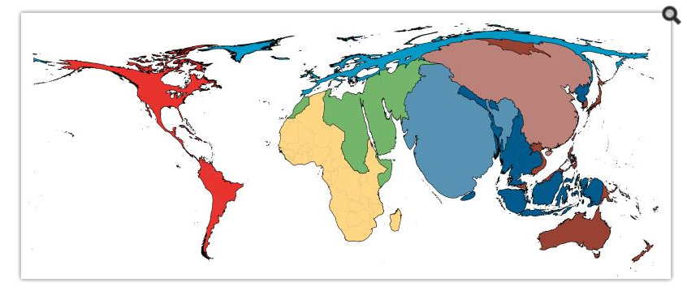
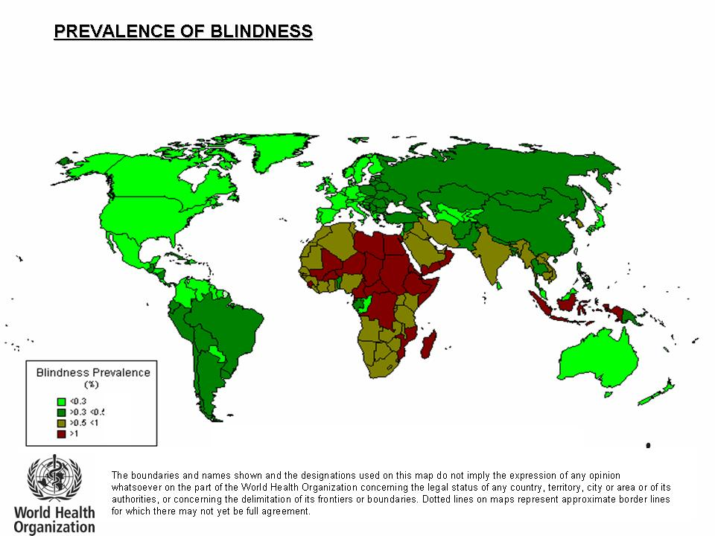
Prevalence of Blindness
http://www.ncbi.nlm.nih.gov/pmc/articles/PMC3457914/
Close to 90% of blind people live in our developing world
Notes:
Statistical analysis can be used to interpret and give meaning to data, however, the ability to interpret large quantities of data and it’s resulting statistical reporting is not always straightforward. Graphical representations such as graphs and maps are a way of translating or converting data in to a visual interpretation.Commonly used world maps are imperfect and contain distortions to allow a spherical reality to be represented in 2-dimensions. This distortion can be manipulated to produce a world map that gives each defined area (country or region) a size proportional to its population.[1]Cartograms are used to effectively map socio-economic data and can be effective means of mapping disease. In keeping with the phrase “a picture equals a thousand words” cartograms can be used to analyse spatial data in an easily comprehensible style

Slide 6
Our challenge
http://www.ncbi.nlm.nih.gov/pmc/articles/PMC3457914/
80% of blindness is avoidable
Notes:
Statistical analysis can be used to interpret and give meaning to data, however, the ability to interpret large quantities of data and it’s resulting statistical reporting is not always straightforward. Graphical representations such as graphs and maps are a way of translating or converting data in to a visual interpretation.Commonly used world maps are imperfect and contain distortions to allow a spherical reality to be represented in 2-dimensions. This distortion can be manipulated to produce a world map that gives each defined area (country or region) a size proportional to its population.[1]Cartograms are used to effectively map socio-economic data and can be effective means of mapping disease. In keeping with the phrase “a picture equals a thousand words” cartograms can be used to analyse spatial data in an easily comprehensible style

Slide 7
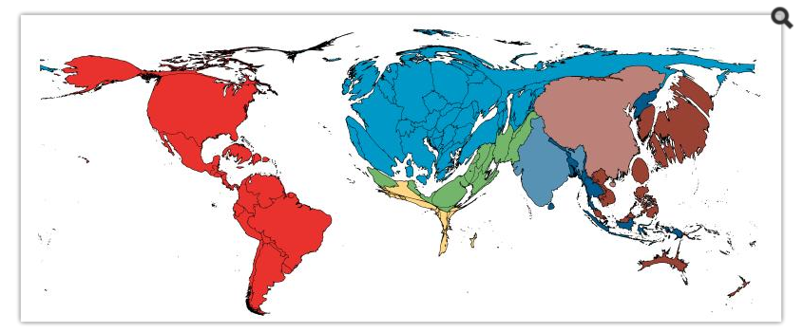
Practicing Ophthalmologists in the World Are Disproportionately Elsewhere
http://www.ncbi.nlm.nih.gov/pmc/articles/PMC3457914/
Notes:
In 1971, Hart[2] described the, “Inverse Care Law” as the availability of good medical care varying inversely with the need for it in the population served. Hart was describing the situation in the National Health Service in Great Britain at the time in which he practiced as both a General Practitioner and an epidemiologist.

Slide 8
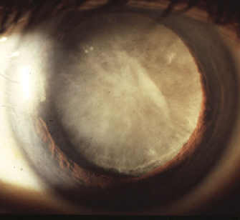
BLIND
43,
,

Slide 9

atvsafety.com
Notes:
That is More people than who live in CA NOT seeing the big E

Slide 10

1.1 BILLLION PEOPLE ARE VISUALLY IMPAIRED
https://www.thelancet.com/journals/langlo/article/PIIS2214-109X(20)30488-5/fulltext#seccestitle10

Slide 11

PRESBYOPIC
https://www.thelancet.com/journals/langlo/article/PIIS2214-109X(20)30488-5/fulltext#seccestitle10

Slide 12
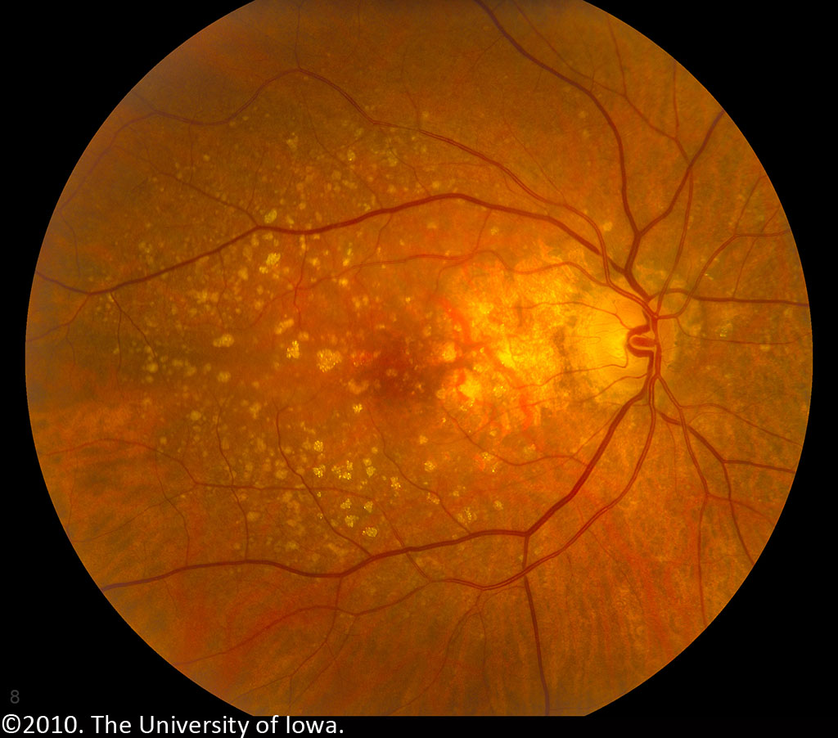
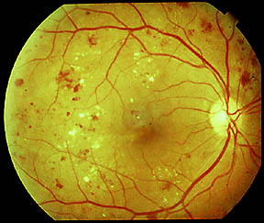
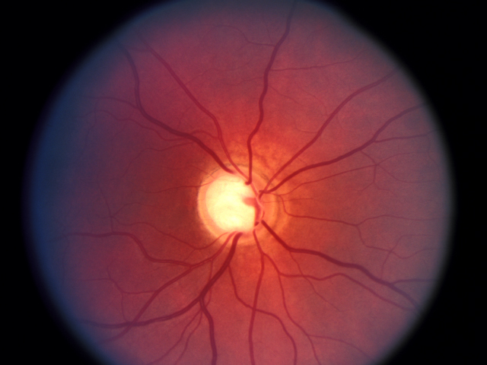
Notes:
Here again is our power map;
north of power

Slide 13
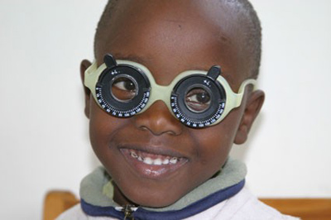
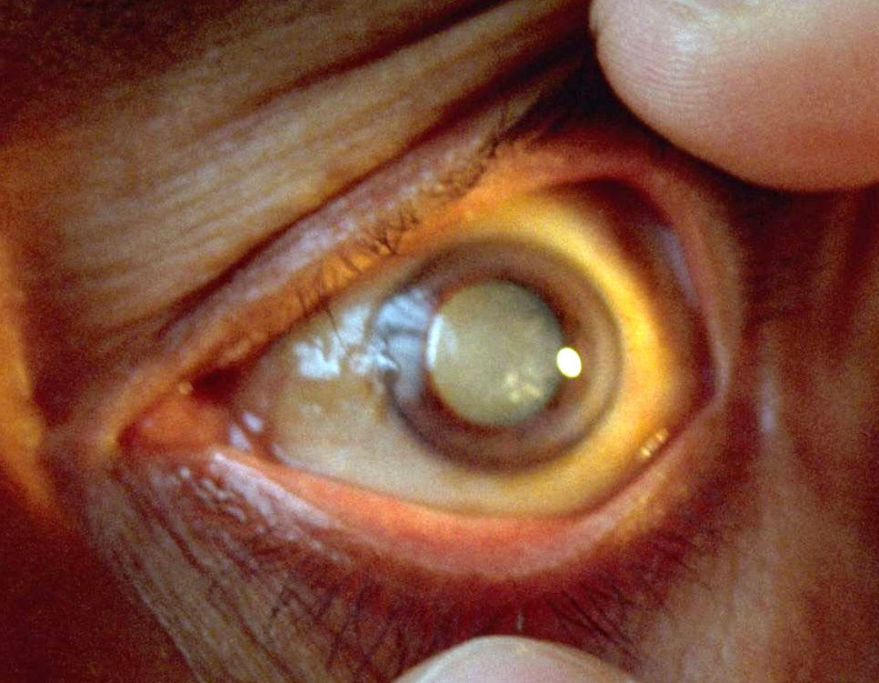
Notes:
SoPo: leading cause of visual impairment, uncorrected refractive error, and of blindness: cataract

Slide 14
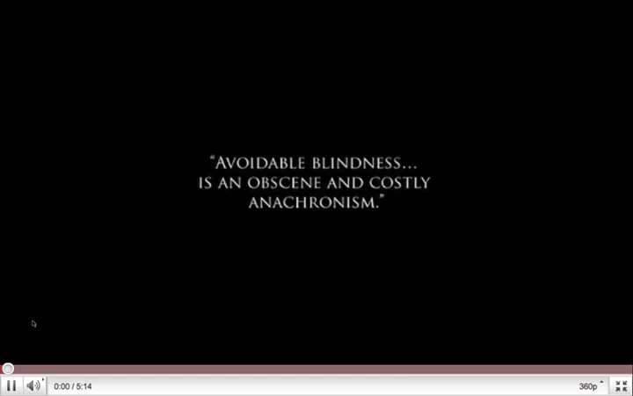

Slide 15
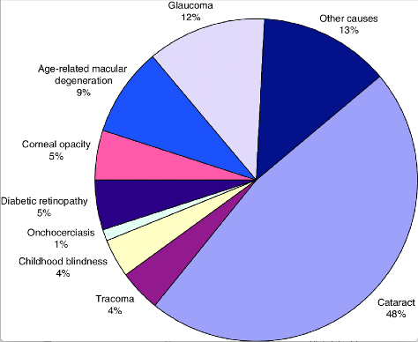
Where are we post Vision 2020?
Age-standardized global prevalence of blindness has fallen by 28% in the past 30 years
Cataract 39%
Resnikoff, Serge & Pararajasegaram, R.. (2008). Blindness. 10.1016/B978-012373960-5.00409-3.
Notes:
Cataract surgery to restore sight is one of the most cost-effective interventions in health care
Infectious causes of blindness are decreasing as a result of public health interventions and socio-economic development. Blinding trachoma now affects fewer than 80 million people, compared to 360 million in 1985

Slide 16
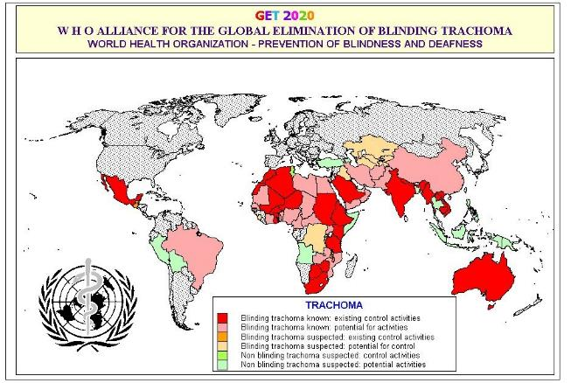
The prevalence of major infectious causes of blindness—onchocerciasis and trachoma—have declined substantially.
Notes:
Trachoma; map of areas affected-- 80 million cases worldwide:

Slide 17

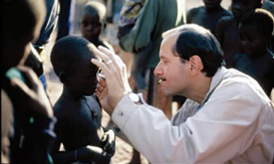
Ophthalmologists are uniquely positioned to Address Global Blindness
EDUCATION
RESEARCH
ADVOCACY
BUILDING PARTNERSHIPS
Notes:
As our world becomes more interconnected and interdependent, we have expanded what “global health means”
ophtho: cataracts, refractive error, disparities in access to care, human resources, global health work-
SERVICE DELIVERY- individual surgeries
CAPACITY BUILDING: , education (telemedicine), lectures, training those abroad here—skills transfer- sandwich fellowships, etc…
INSTITUTION BUILDING,- long term
SYSTEM DELIVERY == DR screening
ACADEMIC COLLABORATION (research and training)
more importantly, broaden our definition– global health in our backyard…

Slide 18
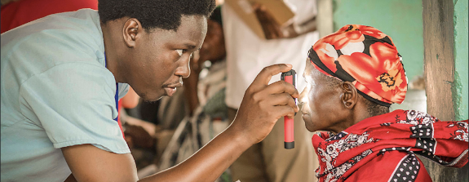
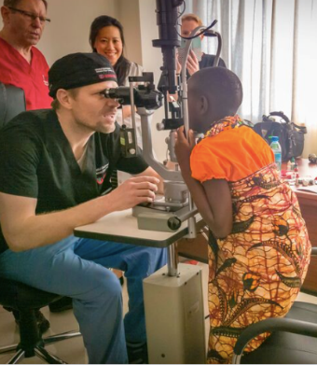
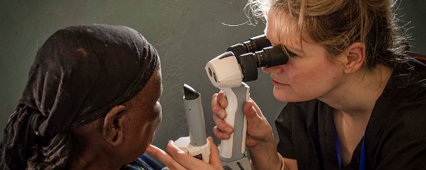
Provide direct, high-quality eye care.

Slide 19
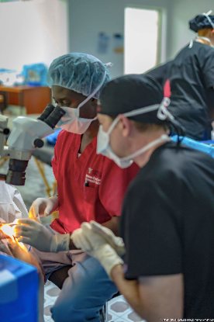
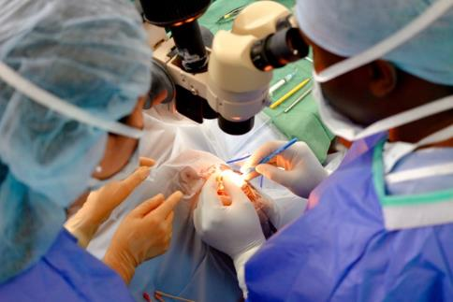
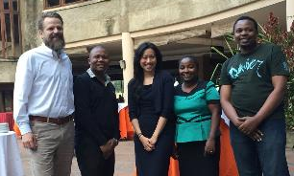
Build human capacity through skills transfer

Slide 20

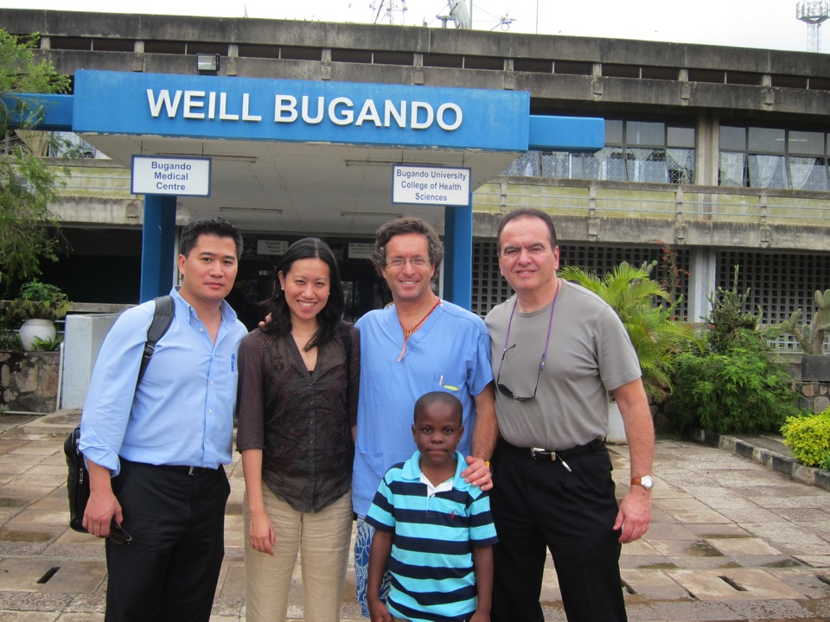
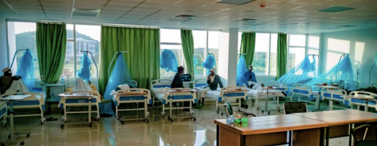
Modernize infrastructure.

Slide 21
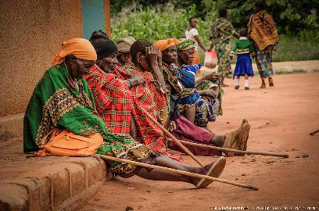
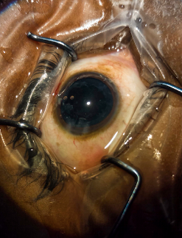
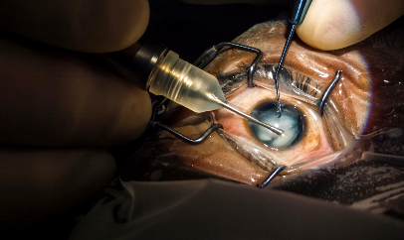

Slide 22
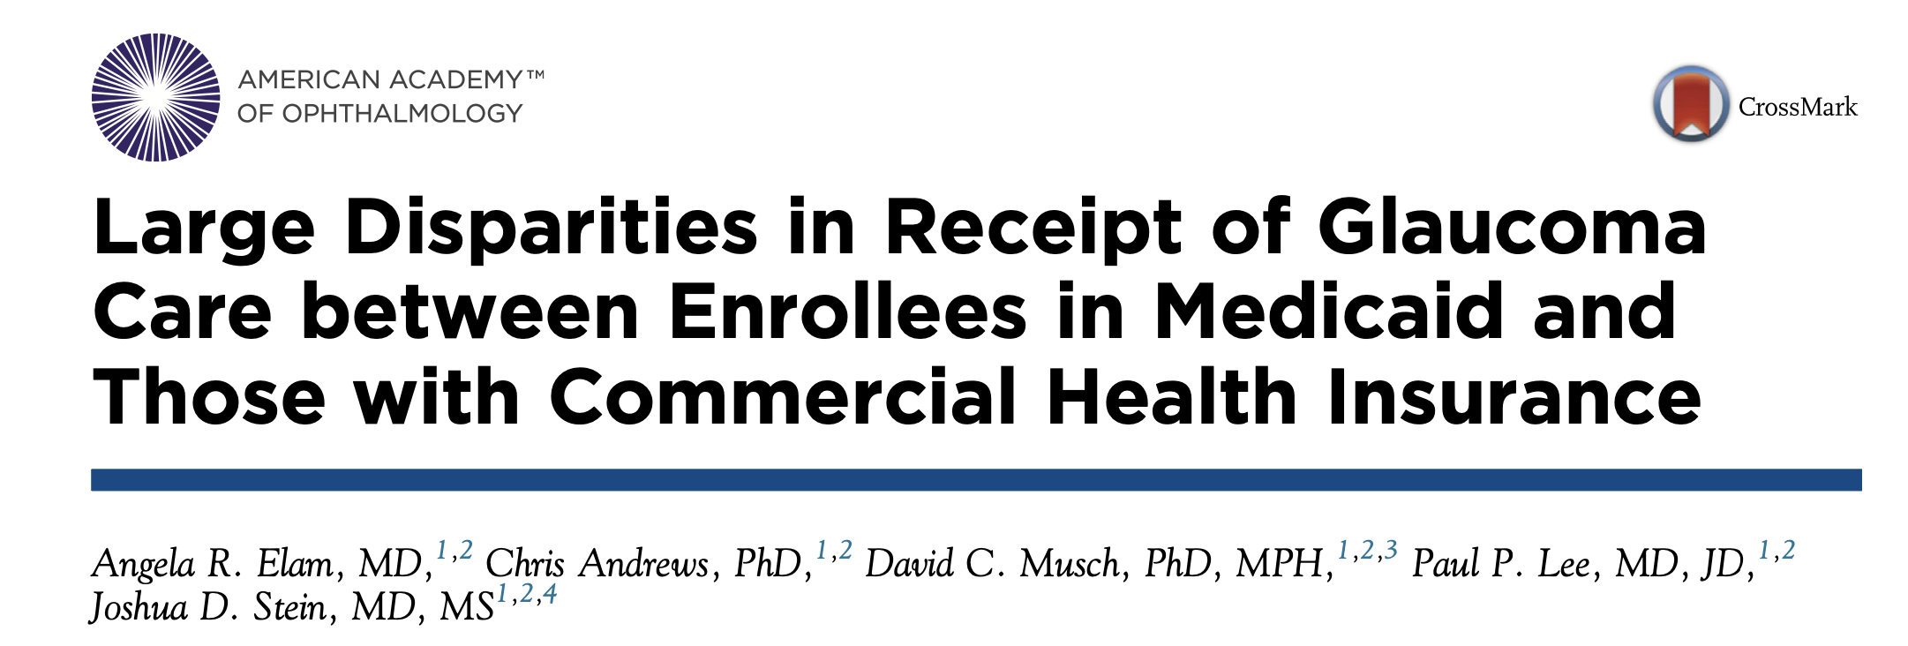

Slide 23
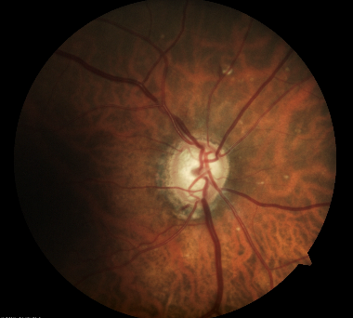
Medicaid patients with a new diagnosis of OAG received substantially less glaucoma testing in the first15 months following initial diagnosis compared with persons with commercial health insurance (234% increased odds of not undergoing glaucoma testing)
Disparity most notable for Black patients with Medicaid (291% increased odds of not undergoing glaucoma testing)

Slide 24
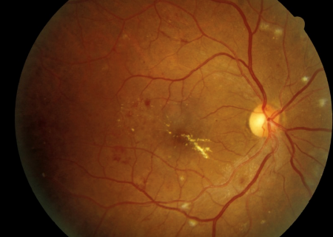
Diabetic Eye Disease
Racial and ethnic minoritized populations have a higher prevalence of diabetic retinopathy and diabetic macular edema, but are less likely to undergo screening dilated fundus examinations than Whites
Underrepresented in clinical trials related to diabetic retinopathy and macular edema
https://www.ncbi.nlm.nih.gov/books/NBK278967/
Coney JM, Scott AW. Racial disparities in the screening and treatment of diabetic retinopathy. J Natl Med Assoc 2022;S0027-9684(21)00236-4.
Berkowtiz ST, Groth SL, Gangaputra S, Patel. S. Racial/ethnic disparities in ophthalmology clinic trials resulting in US Food and Drug Administration Approvals from 2000 to 2020. JAMA Ophthalmology 2021;139:629-637.
Bowe T, Salabati M, Soares R, Huang et al. Racial, ethnic, and gender disparities in diabetic macular edema clinical trials. Ophthalmology Retina 2022;S2468-6530(22)00040-9.
Notes:
Coney JM, Scott AW. Racial disparities in the screening and treatment of diabetic retinopathy. J Natl Med Assoc 2022;S0027-9684(21)00236-4.
Berkowtiz ST, Groth SL, Gangaputra S, Patel. S. Racial/ethnic disparities in ophthalmology clinic trials resulting in US Food and Drug Administration Approvals from 2000 to 2020. JAMA Ophthalmology 2021;139:629-637.
Bowe T, Salabati M, Soares R, Huang et al. Racial, ethnic, and gender disparities in diabetic macular edema clinical trials. Ophthalmology Retina 2022;S2468-6530(22)00040-9.

Slide 25
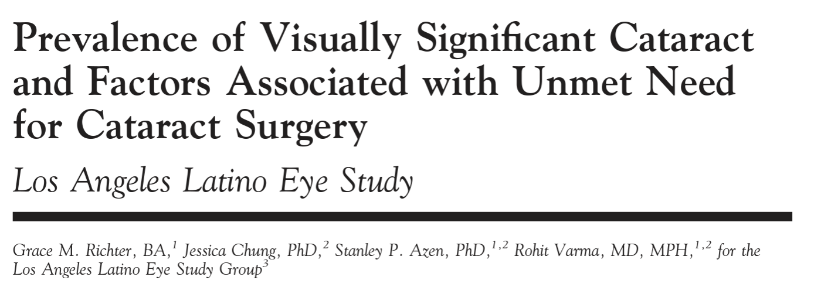
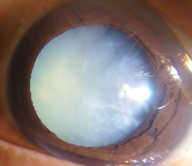
population-based, cross-sectional study of 6142 Latinos 40 years and older
344 participants were determined to have needed cataract surgery
  34% of participants had an unmet need for cataract surgery
Factors associated with not having cataract surgery
  having last eye examination 5 years ago compared with 1 year ago
  being uninsured
  income less than $20,000
  self-reported barriers to eye care

Slide 26
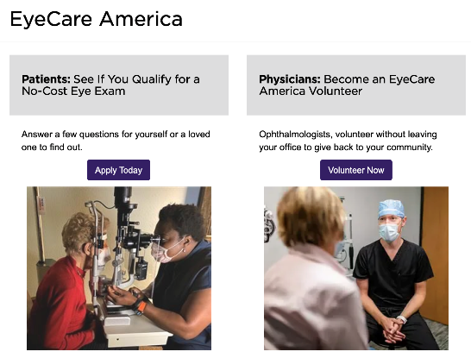
Become an Eye care America volunteer

Slide 27
SUMMARY: Vision needs to be reframed as a development issue
Eye health is essential to achieve the WHO Sustainable Development Goals;
Almost everyone will experience impaired vision or an eye condition during their lifetime and require eye care services; urgent action is necessary to meet the rapidly growing eye health need
High quality eye health services are not universally delivered; concerted action is needed to improve quality and outcomes, providing effective, efficient, safe, timely, equitable, and people-centered care
Highly cost-effective vision-restoring interventions offer enormous potential to improve the economic outlook of individuals and nations; a major scale up of financial investment in eye health is required
https://www.thelancet.com/journals/langlo/article/PIIS2214-109X(20)30488-5/fulltext#gr23

Slide 28
VISION LOSS IS A HUGE ECONOMIC BURDEN
For 2020, we estimate that vision impairment resulted in $410·7 billion lost economic productivity; the full cost is most likely higher
Treatments for cataract and refractive error would meet more than 90% of unmet needs and are highly cost-effective
Highly cost-effective vision-restoring interventions offer enormous potential to improve the economic outlook of individuals and nations; a major scale up of financial investment in eye health is required

Slide 29
SUMMARY
Financial barriers to accessing eye care leave many people behind; eye health needs to be included in national health financing to pool the risk
Technology and treatment developments offer new tools to improve eye health; thoughtful application is needed to maximize the potential to improve coverage, accessibility, quality, efficiency, and affordability
The eye health workforce is unable to meet population needs in many countries; major expansion in service capacity is required
Research has been crucial to advances in understanding and treating eye disease; solution-focused, contextually relevant research is urgently needed to deliver innovative prevention and treatment strategies and inform implementation of eye health within universal health coverage
https://www.thelancet.com/journals/langlo/article/PIIS2214-109X(20)30488-5/fulltext#gr23

Slide 30
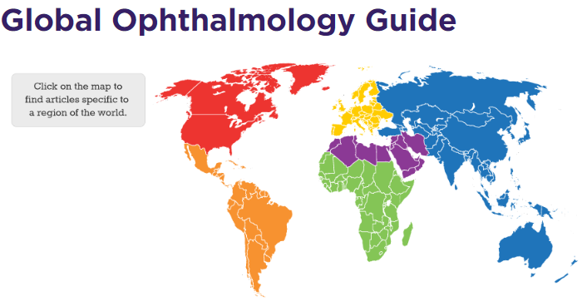
AAO Resources for interested in Global Ophthalmology
AAO GO Guide
  Provides educational listings, videos, online courses & more for those who have a desire to deliver care in underserved areas of the world
https://www.aao.org/global-ophthalmology-guide

Slide 31
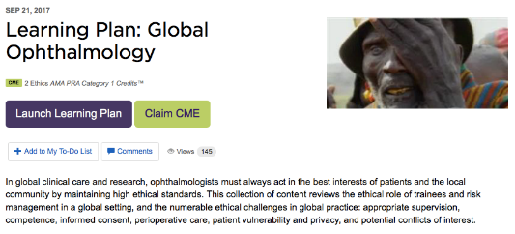
AAO Global Ophthalmology Resources

Slide 32




Other Opportunities in Global Ophthalmology

Slide 33
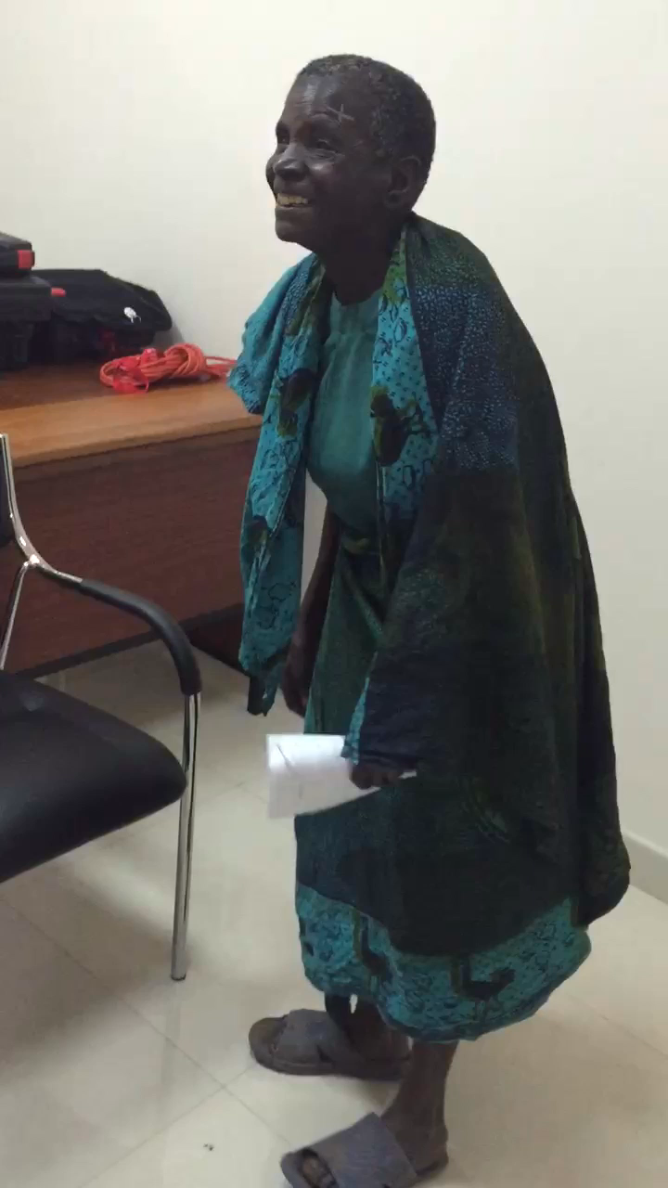

Slide 34

THANK YOU!
grs2003@med.cornell.edu
Notes:
I BELIEVE WE CAN help TURN ON the LIGHTS in lower Manhattan… AND AROUND THE WORLD

