Slide 1
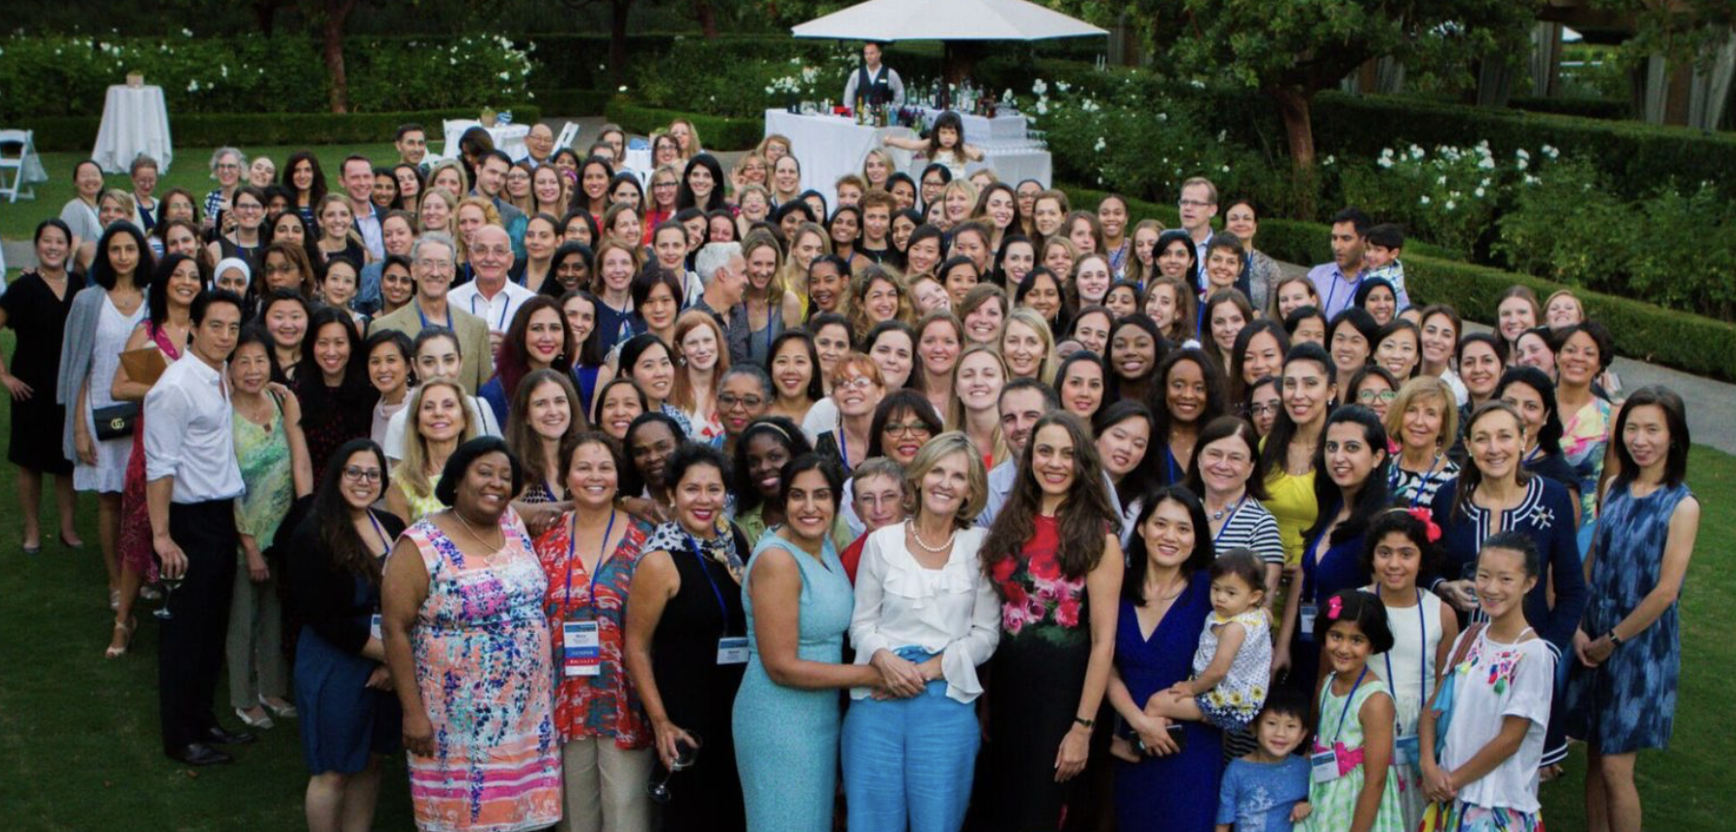

An Eye on Women’s Eye Health and Gender Equity
Grace Sun, MD
Associate Professor in Ophthalmology
New York Presbyterian Hospital/Weill Cornell Medical College
President, Women in Ophthalmology

Slide 2
Financial Disclosures
No financial disclosures or commercial relationships

Slide 3

Learning objectives
Describe how sex and gender can impact eye health outcomes
Identify health disparities as it relates to women
Describe the ophthalmology workforce: women in ophthalmology
Propose a path forward to achieve health equity

Slide 4
SEX and gender
Sex is a biological variable that can influence the function of processes in males and female
  Can be seen in pathophysiology of disease
  Seen in prevalence in outcomes of disease
  Can be seen in outcomes testing drug effects
Gender- person’s self representation in response to social and environmental experiences
Both sex and gender are important when considering women’s eye health

Slide 5
Society for Women’s Health research :
Women’s Eye Health Working Group
A group of clinicians, patient advocates and researcher tasked to:
  Assess the state of the science regarding sex and gender differences in women’s eye health across the lifespan
  Examine a spectrum of vision disorders that disproportionately or exclusively impact women to identify key influences and determinants (e.g., biological, behavioral, and societal) for these disparities; and
  Develop recommendations to advance the research agenda, diagnostic and treatment strategies and to address gaps in awareness, education, and stakeholder engagement

Slide 6
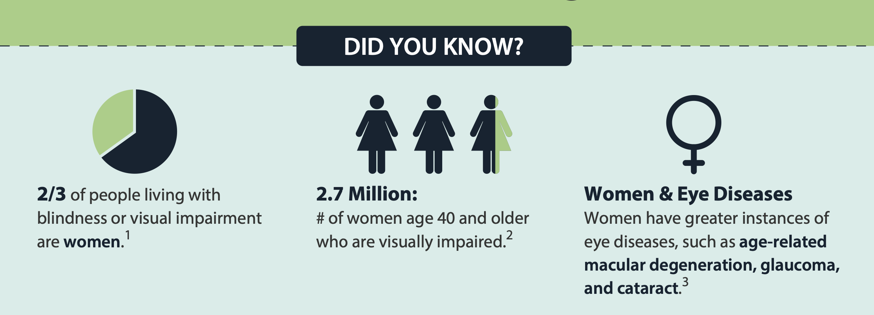

Slide 7
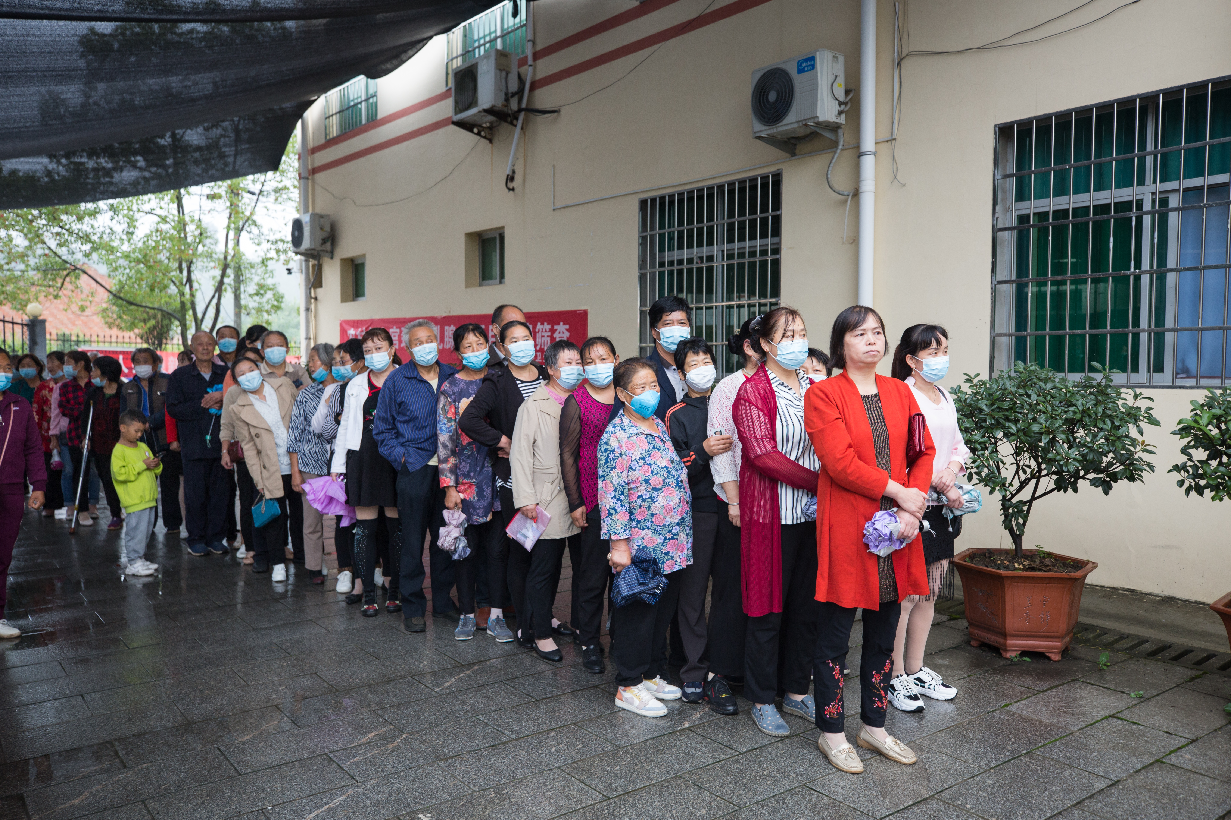
Women and girls make up 55% of the world’s vision impaired
World blindness and visual impairment: despite many successes, the problem is growing - PMC (nih.gov)
Notes:
Globally, 1.1 billion people live with vision loss, including blindness. Women and girls make up 55% of those people – that’s 112 million more women than men. Many barriers prevent both women and men from accessing eye health services, but these barriers can often be more problematic for women- meaning that over half of the population is unable to reach their full potential due to vision loss. (IAPB)

Slide 8
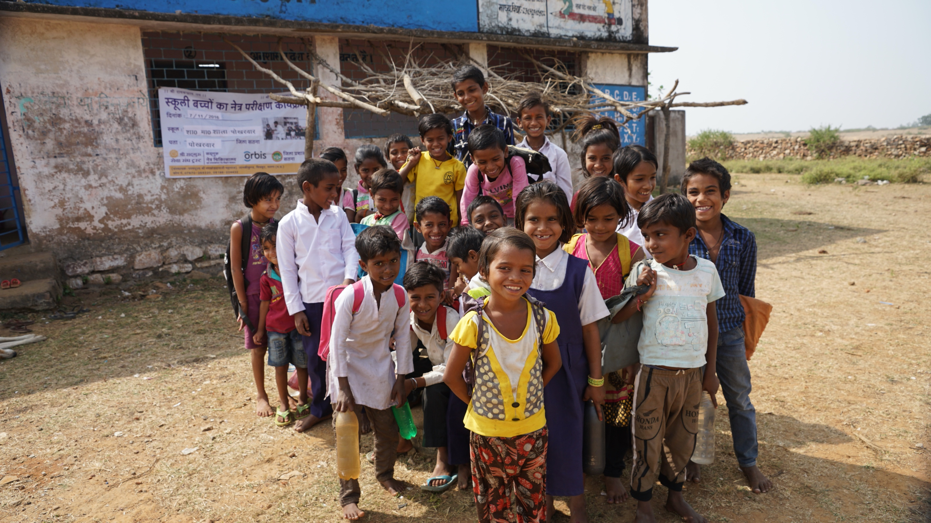
2 out of 3 children who are blind are girls
seva_canada_gender_and_blindness_booklet_2018.pdf

Slide 9
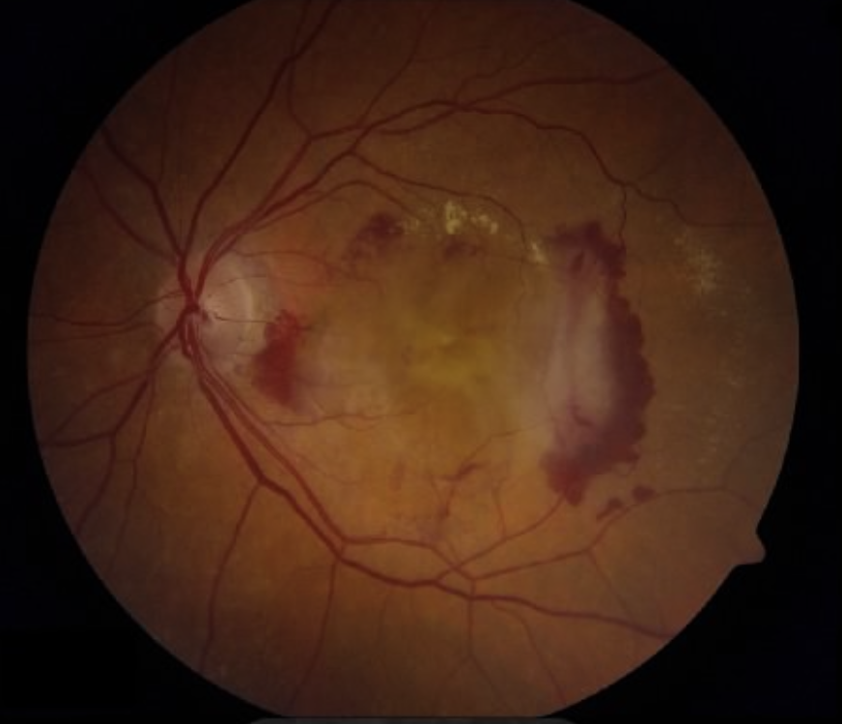
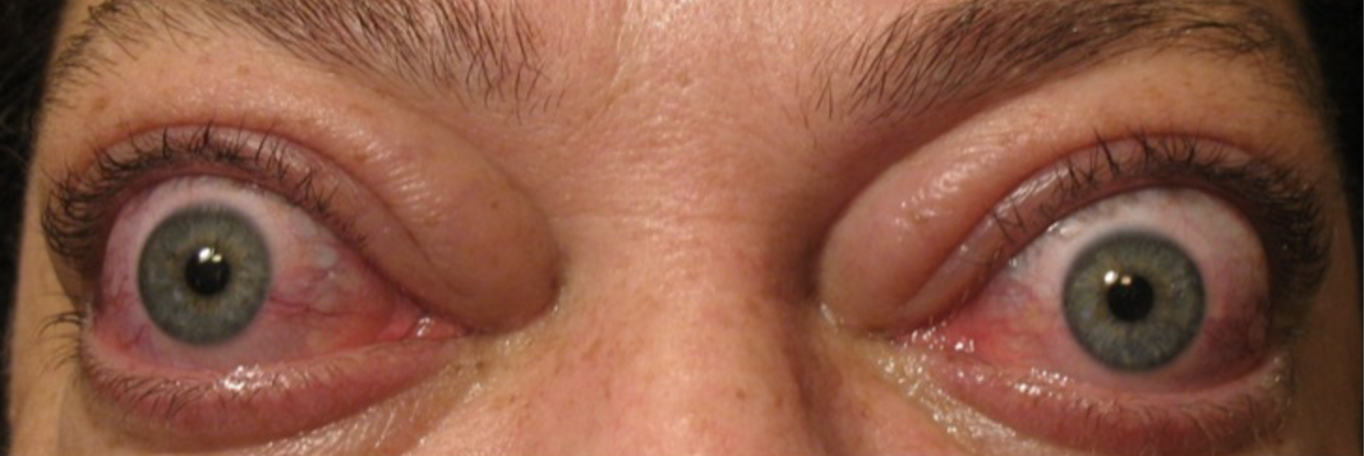
women have higher rates of eye disease
AMD-
Global burden of disease is increased in women in age and sex adjusted studies
DALYS – higher burden of disability
Thyroid Eye Disease
Higher prevalence in women, affecting 16 women vs 3 men per 100,000 people annually
Patient responses to treatment can vary due to sex-based genetic and biochemical influences, as well as age, disease severity, and symptom severity
Dry eye and Ocular surface Pain
The gender disparity in DED corresponds with age—for individuals over 50 years, women are twice as likely to have diagnosed DED compared to men
Women are often diagnosed at younger ages than men and experience more severe symptoms
https://eyewiki.aao.org/File:Classic_CNVM_panel.jpg
https://eyewiki.aao.org/File:Manifestations_of_TED.jpg

Slide 10
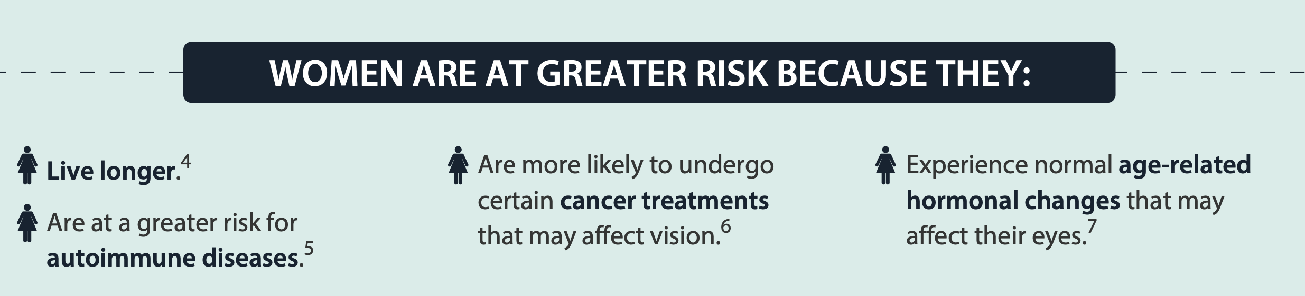
Why are women at greater risk for vision loss?
Pregnancy
Diabetic retinopathy
  Women with pre-existing diabetes mellitus can develop and are more likely to experience worsened DR during pregnancy
  Pregnant woman who has gestational diabetes is at risk for developing
Pre-eclampsia and Eclampsia
Intimate partner abuse

Slide 11
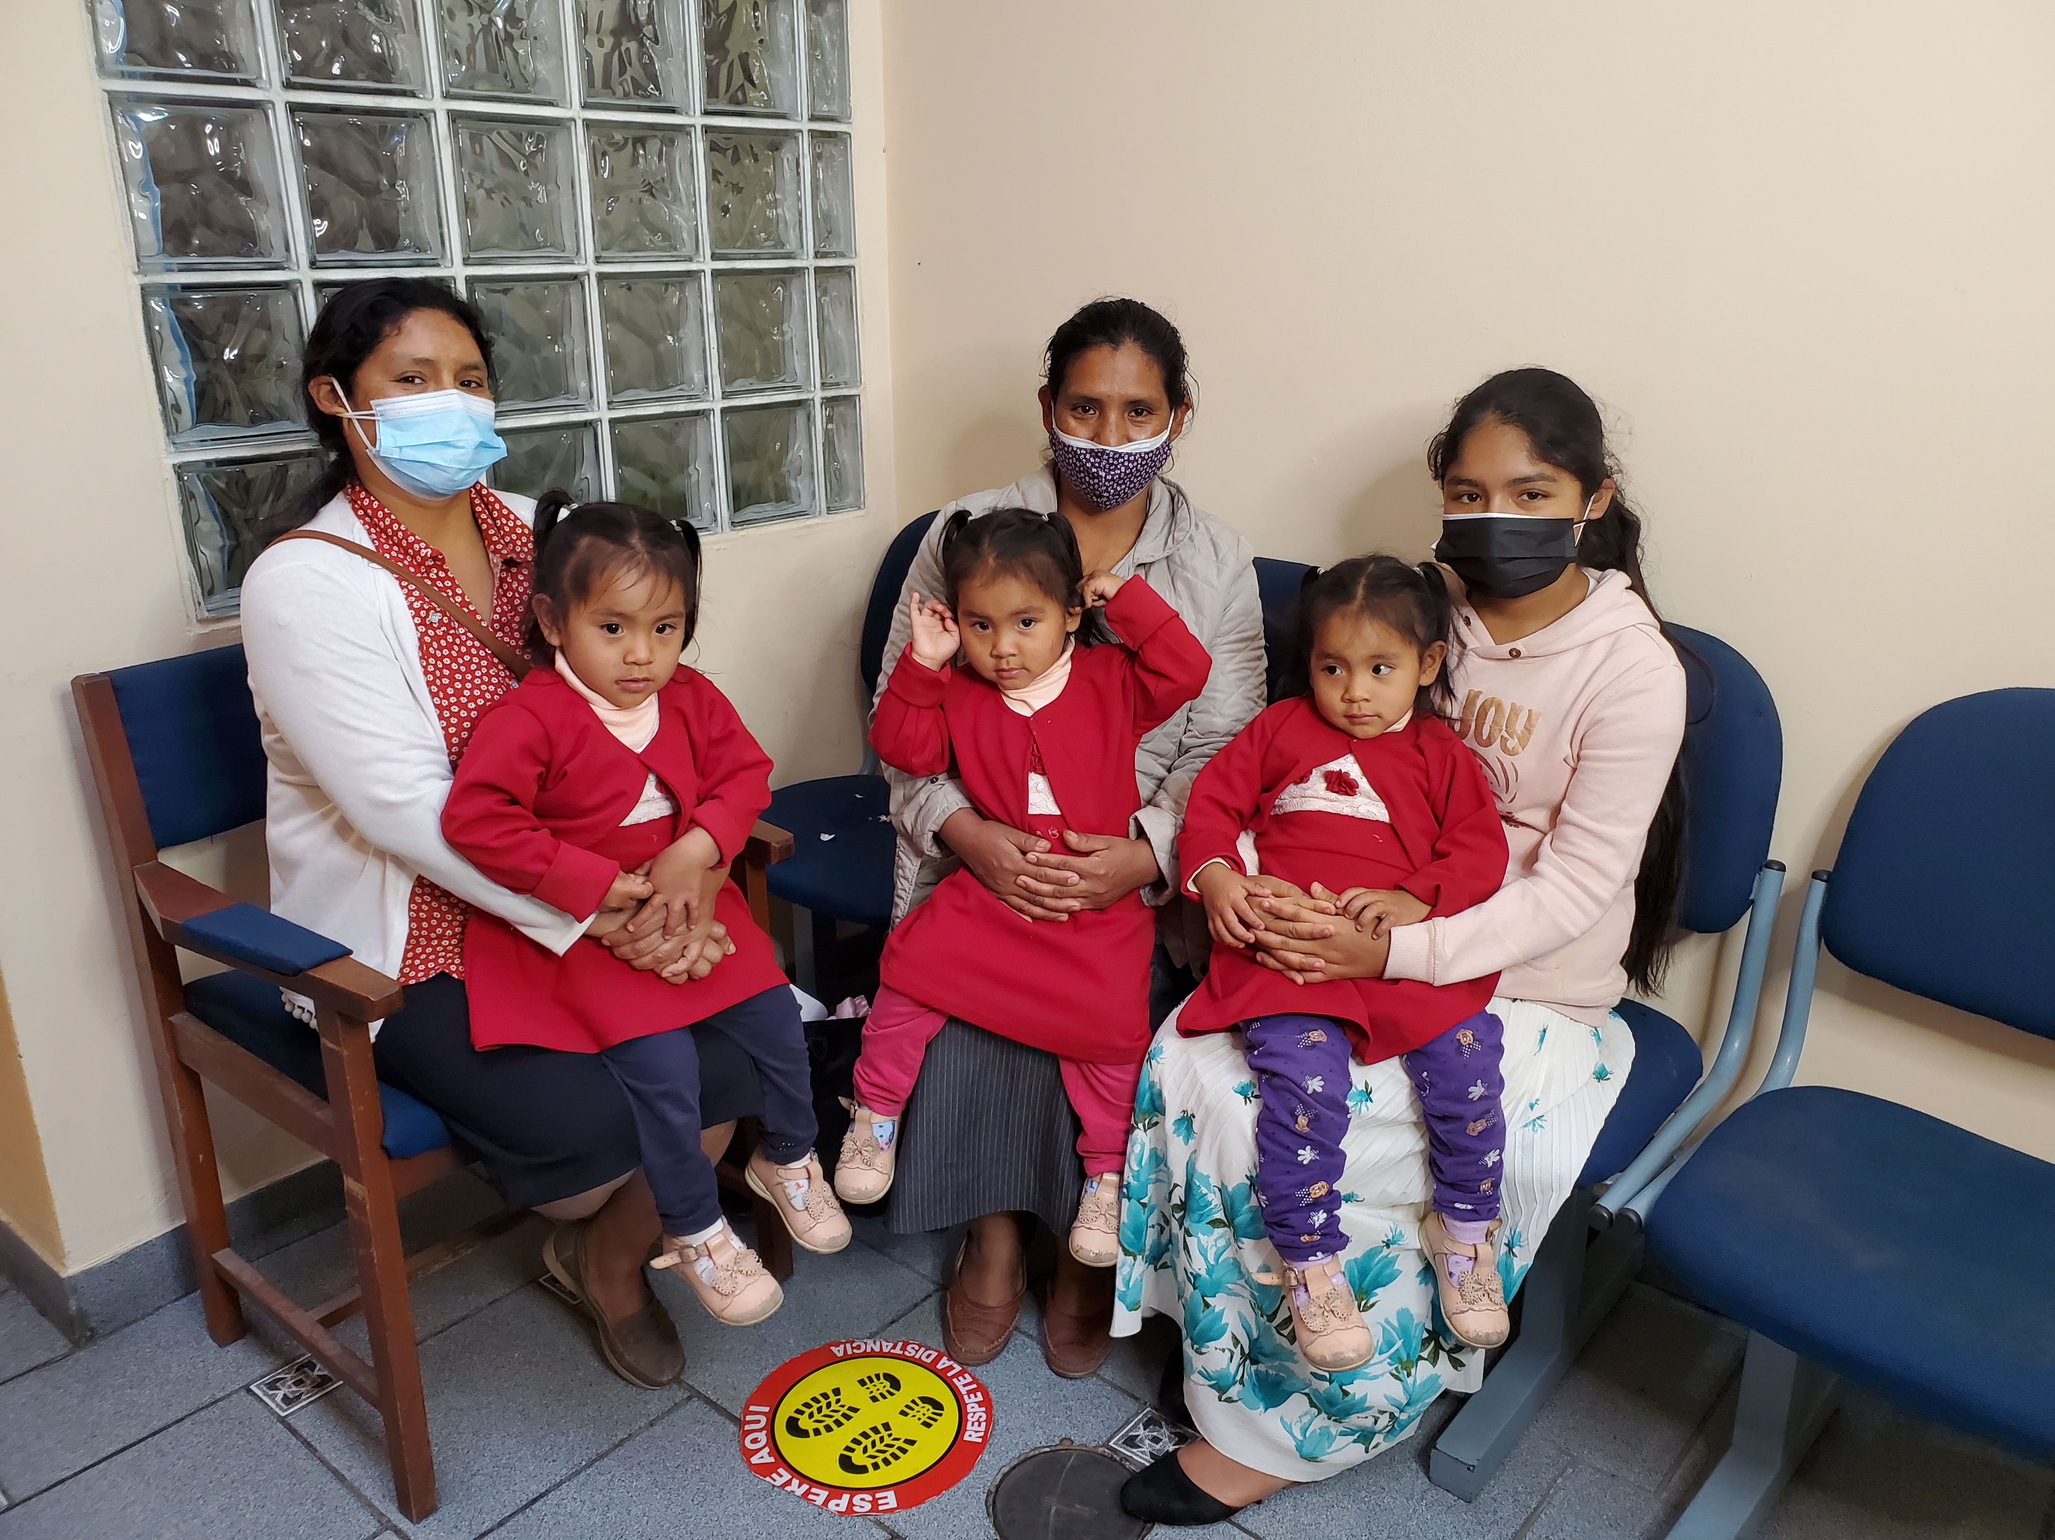
Causes for gender inequities
Household and childcare responsibilities
Limited resources
Safety concerns and costs
Too few female eye health care providers
Low literacy and access
Notes:
1. Household and childcare responsibilities leave women with little time to tend to their own needs.
2. Limited resources are often directed first toward the needs of men and boys in patriarchal societies, forcing women and girls to go without.
3. Safety concerns limit women’s ability to travel for care.
4. Too few female eye health care providers are available to care for women and girls who, for cultural or other reasons, will not seek care from a male practitioner.
5. Low literacy, resulting from restricted access to education, means women are less likely to know how or where to access the eye care they need.

Slide 12
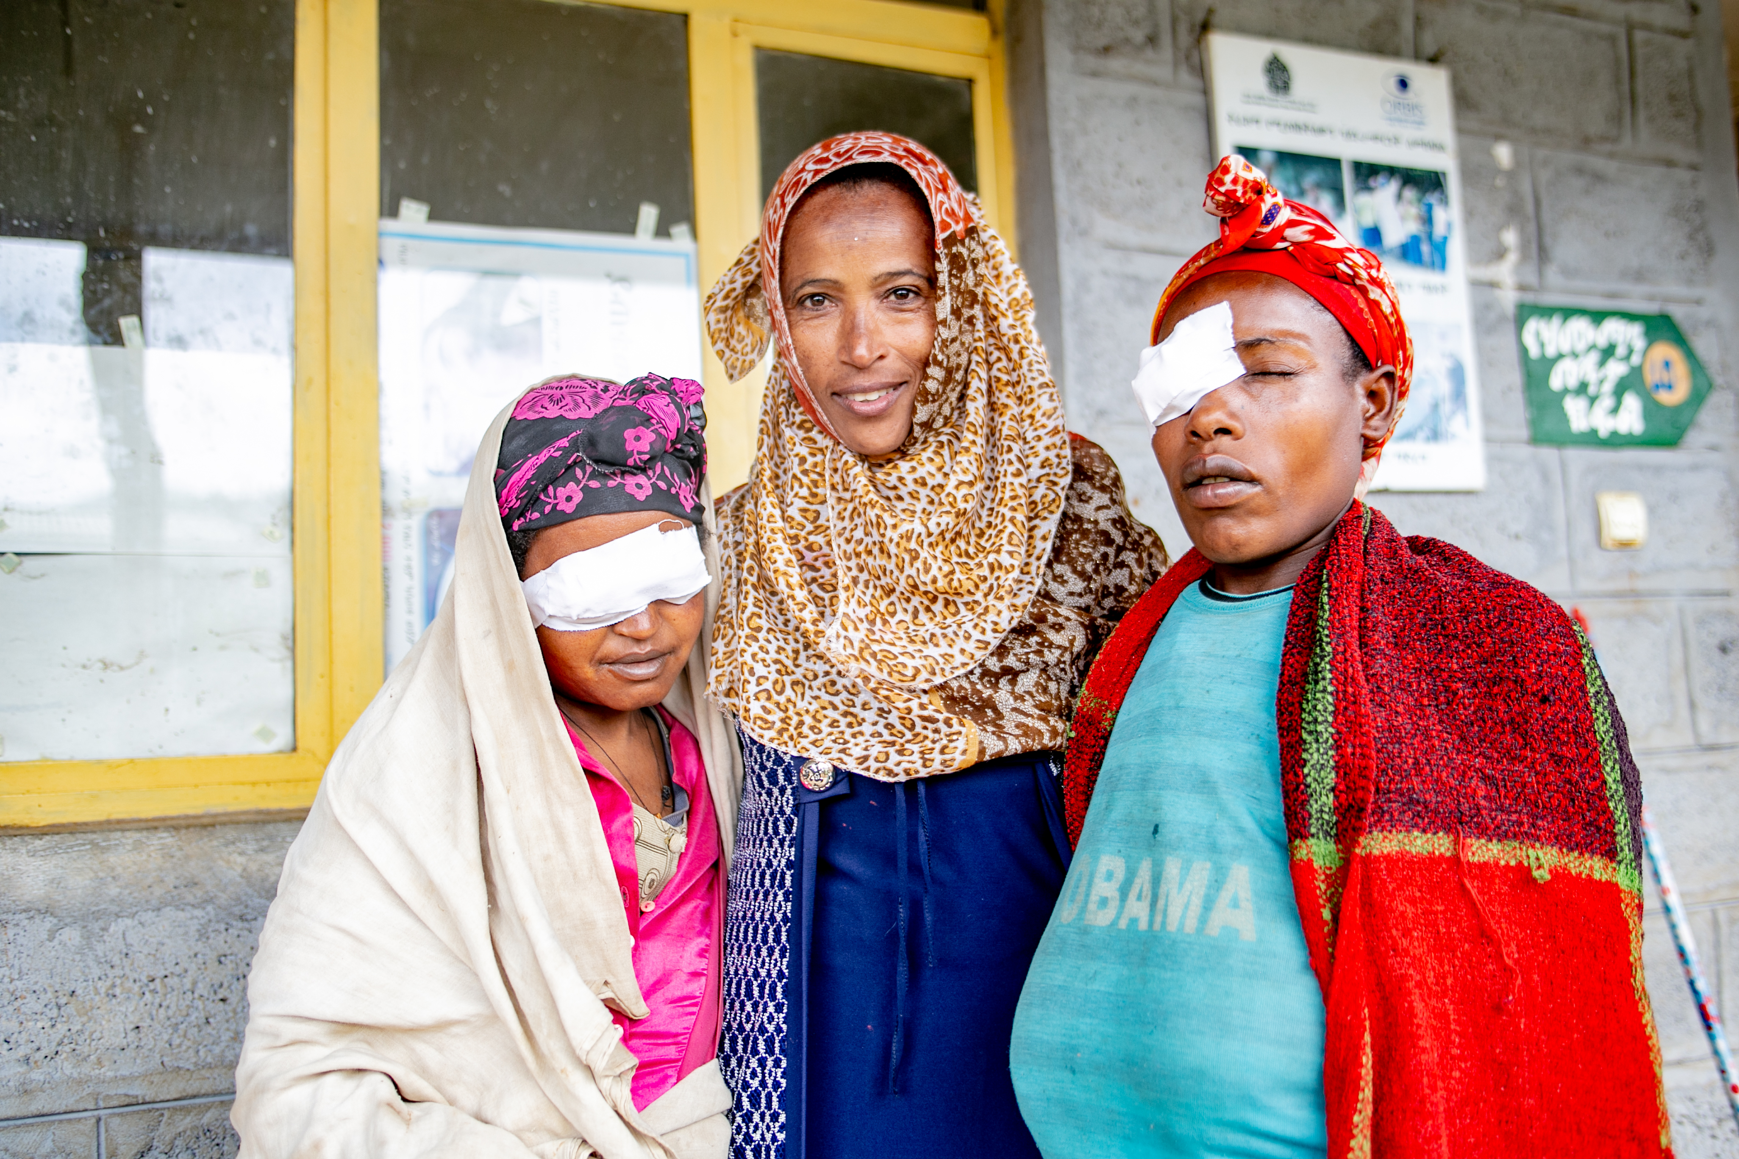
70% of people affected by blinding trachoma are women.
Contribution of sex-linked biology and gender roles to disparities with trachoma - PubMed (nih.gov)
Notes:
Traditional gender roles also put women more at risk of infectious eye diseases. Take trachoma, the world’s leading infectious cause of blindness which results in a blinding condition called trachomatous trichiasis, where the eye lashes rub painfully against the eye.
In areas where trachoma is endemic, it is common among young children. Women make up 70% of people affected by this painful and blinding disease because of their caregiving duties. Women become blind from trachoma up to four times as often as men – most likely because of repeated infections from contact with children.

Slide 13
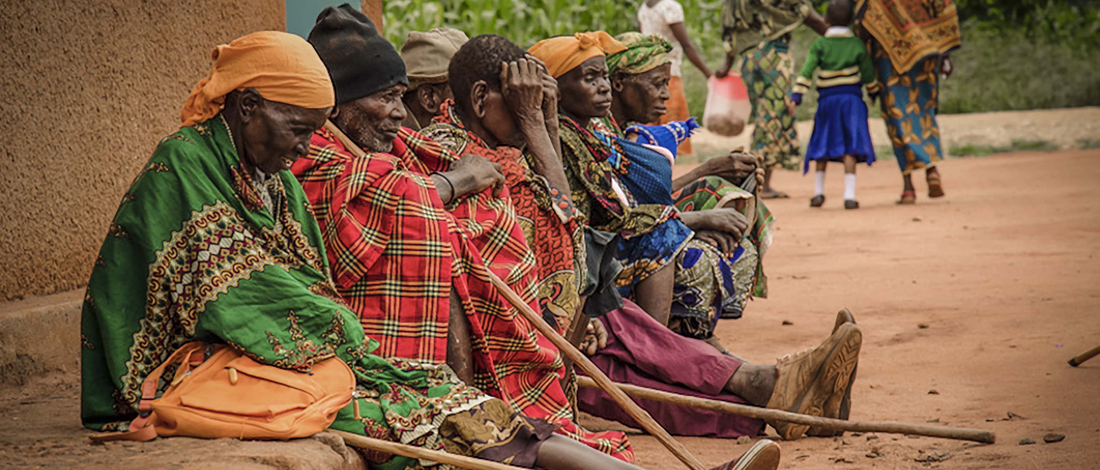
Cataract surgical coverage remains lower in women
https://www.thelancet.com/journals/langlo/article/PIIS2214-109X(22)00419-3/fulltext

Slide 14
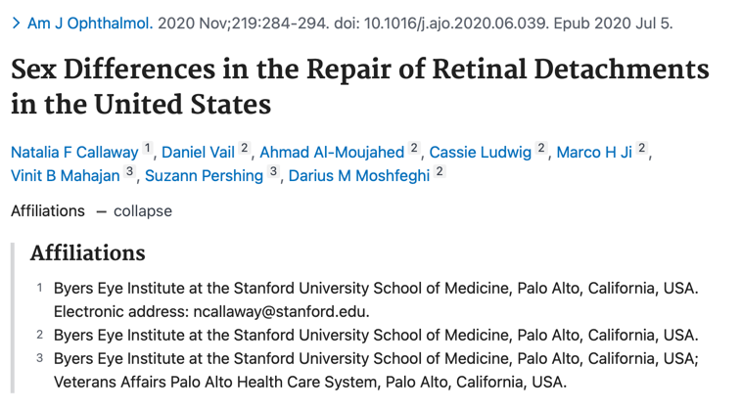
There may be SEX differences in treatments and outcomes

Slide 15
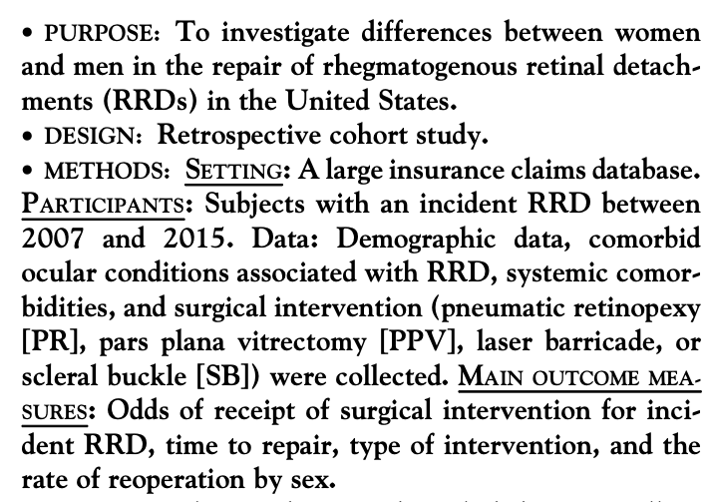
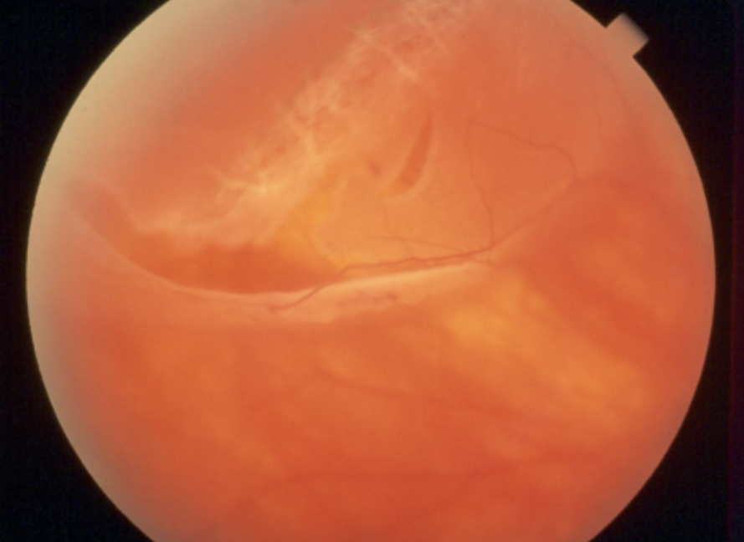
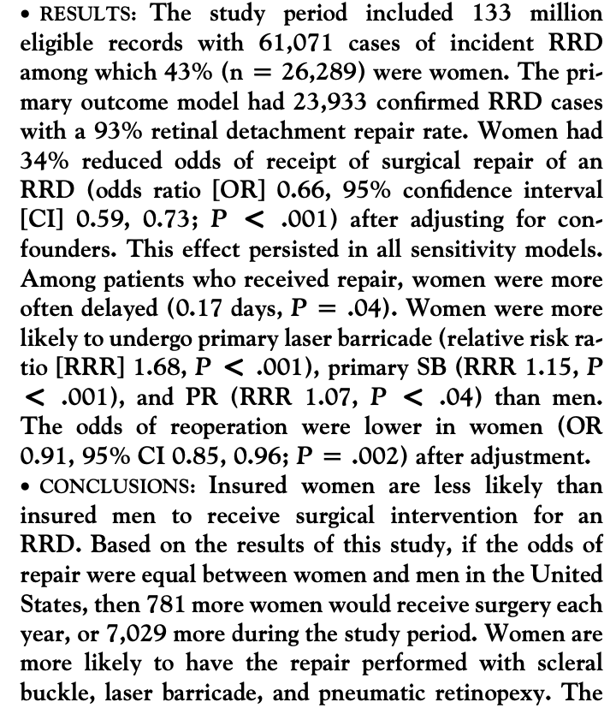
https://eyewiki.aao.org/File:AA0_3379.png
Truven Health MarketScan
Commercial Claims and Encounter
Database
150 million US beneficiaries
>350 insurance carriers

Slide 16
Addressing gender inequality will help advance eye health.
Adopting a research framework to guide future work that incorporates sex and gender lenses to investigate health disparities and inequities in women’s eye health care and disease
Using population health approaches to develop integrative systems to reduce disparities and improve overall eye health care for women at the individual, community, and systems levels
Increasing patient and provider education and awareness by standardizing medical curricula and expanding partnerships between eye care providers (e.g., ophthalmologists, optometrists), researchers, and non-vision providers to incorporate women’s eye health into mainstream health
Aninye, I.O., Digre, K., Hartnett, M.E. et al. The roles of sex and gender in women’s eye health disparities in the United States. Biol Sex Differ 12, 57 (2021). https://doi.org/10.1186/s13293-021-00401-3

Slide 17

The Representation of Women in the Ophthalmology Continues to Increase
Leadership
Academics
Research
Income
Surgical Training
Mentorship
Gill HK, Niederer RL, Shriver EM, Gordon LK, Coleman AL, Danesh-Meyer HV. An Eye on Gender Equality: A Review of the Evolving Role and Representation of Women in Ophthalmology. Am J Ophthalmol. 2022 Apr;236:232-240. doi: 10.1016/j.ajo.2021.07.006. Epub 2021 Jul 17. PMID: 34283980.

Slide 18
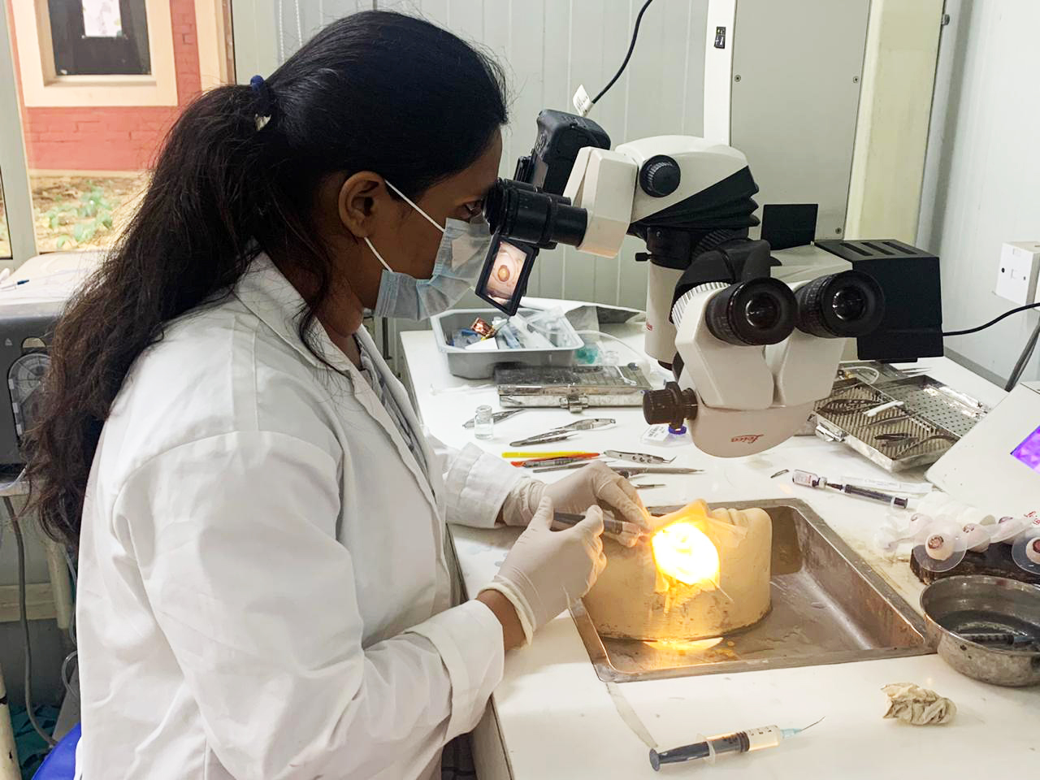
  Within the medical field, women represent 25-30% of ophthalmologists and 25-45% of trainees globally, yet they are underrepresented in key leadership positions.
An Eye on Gender Equality: A Review of the Evolving Role and Representation of Women in Ophthalmology - PubMed (nih.gov)
Notes:
This is not an uncommon pattern within the medical community, where there are clear examples of underrepresentation of women physicians across numerous specialties and among professional award recipients.¹⁶

Slide 19
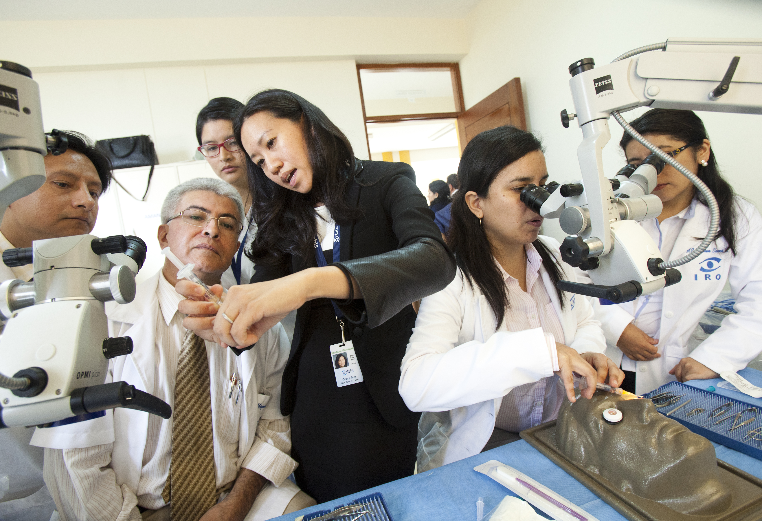
Women make up most of the global health and social care force (70%) while 75% of leadership roles in health are still held by men.
Value gender and equity in the global health workforce (who.int)

Slide 20
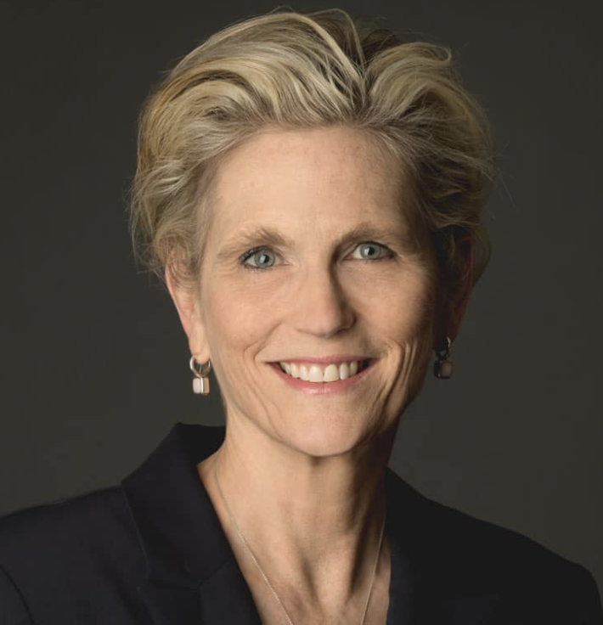
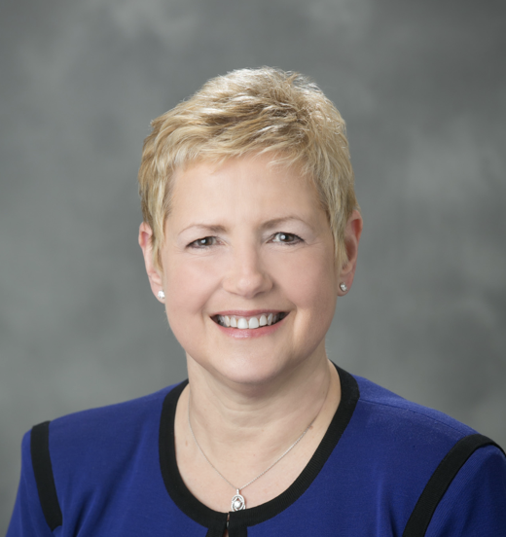
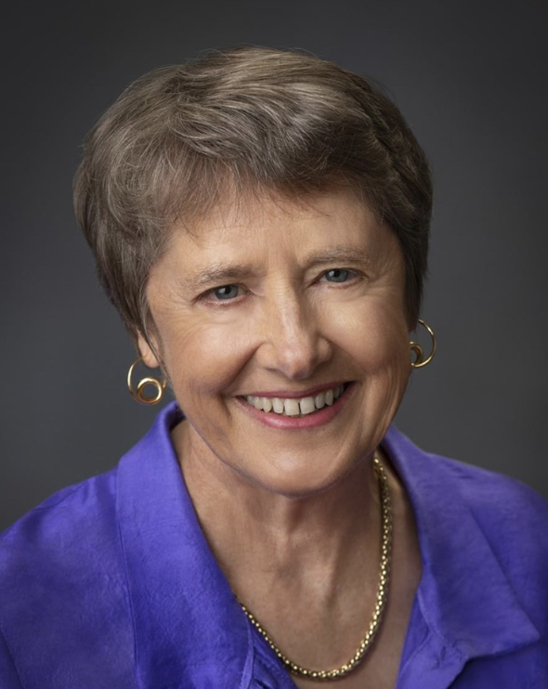
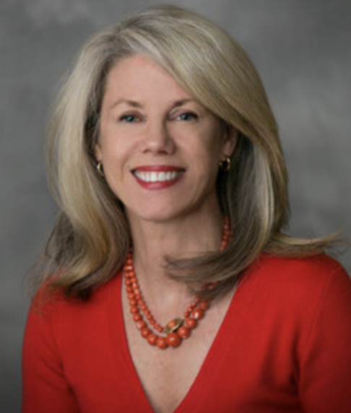
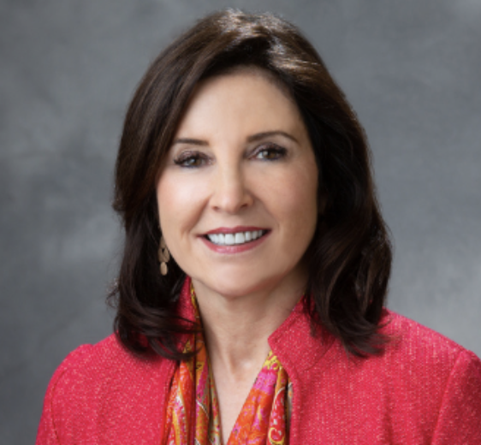
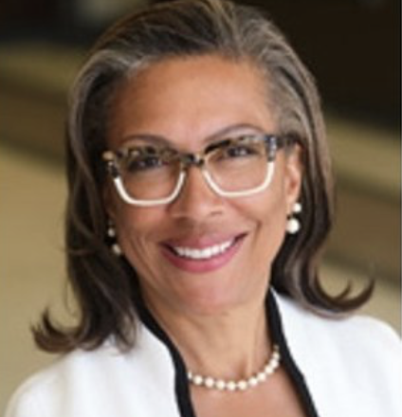
LEADERSHIP
Academic Chairs: recently as 2018, of the 111 ophthalmology programs in the United States, fully 100 of them were chaired by men. This means that only slightly more than 10% of programs today – barely double digits in absolute numbers – are led by women
Fewer than a third of residency program directors are female
2020 publication by Camacci et al found that of the 15 ophthalmic societies analyzed, only 2 had women presidents (13.3%), and of the 20 highest-ranked ophthalmic journals, only 1 had a woman editor-in-chief (4.2%) .
Women are still underrepresented as award recipients in many ophthalmology subspecialties.
Dotan G, Qureshi HM, Gaton DD. Chairs of United States Academic Ophthalmology Departments: A Descriptive Analysis and Trends. Am J Ophthalmol. 2018 Dec;196:26-33. doi: 10.1016/j.ajo.2018.08.016. Epub 2018 Aug 16. PMID: 30121244.

Slide 21
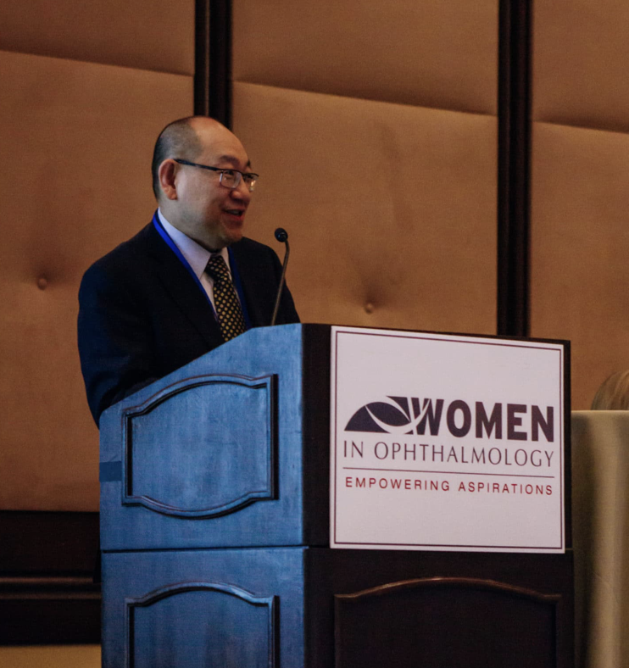
ACADEMICS and RESEARCH
In 2020, women account for 24% of professors, 38% of associate professors, 49% of assistant professors, and 53% of instructors of ophthalmology at US medical schools, emphasizing an under-representation of women in senior ranks.
In a 2014 study, women principal investigators were less likely to receive grants in their early careers from the National Institutes of Health (NIH) and received smaller awards than men.
Women ophthalmologists established fewer industry partnerships and attracted less industry funding (Reddy et al)
Multiple studies have documented a gender disparity in the first and last authorship
Kalavar et al noted a significant gender association between first and last authors, with authors more likely to collaborate with people of the same gender.

Slide 22

INCOME
Ophthalmology to have one of the largest gender pay gaps of all specialties, with men reportedly earning 36% more than their women
2020 US data demonstrated that this gap persists, reporting that women ophthalmologists earn 12.5% less than men in the first year of clinical practice, with salary differences persisting after controlling for demo- graphic, educational, and practice type.
Explanations for gender pay gaps are varied and multifactorial
One notable difference is that women are less well-represented in surgical subspecialties (such as vitreoretinal surgery), perform less procedural work, and have fewer operative hours than men

Slide 23
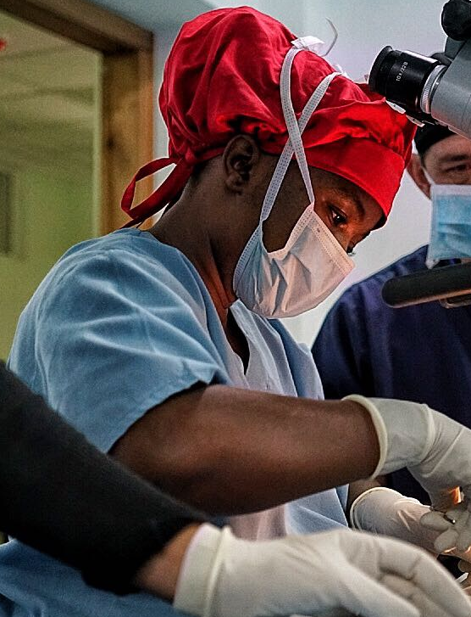
SURGICAL Training and Harassment
Women trainees report having fewer surgical opportunities, with resultant disparities in surgical numbers of surgical procedures completed
Study in 2019 in United States found that women residents performed up to 22 (12.5% ) fewer cataract operations and 80 (15.7%) fewer total procedures compared with men over the period of 2005-2017
Women ophthalmologists who re- port higher rates of discrimination, harassment, sexual harassment, and bullying than men
A recent survey of ophthalmologists who took part in a sexual harassment workshop reported that 100% of women and 58% of men had personally experienced patient-initiated sexual harassment during their career

Slide 24
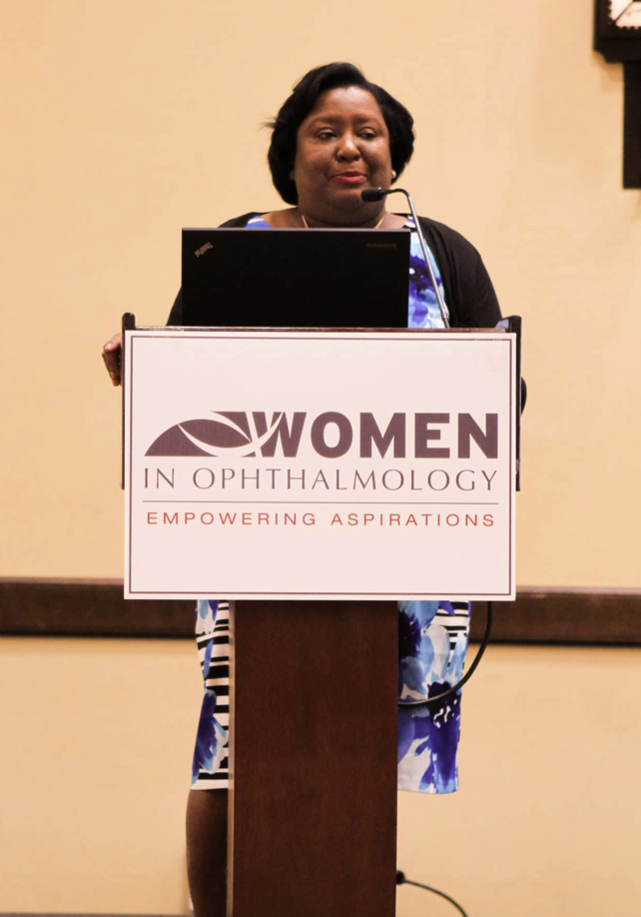
Achieving gender equality is a complex path, and therefore solutions will need to be multifaceted.
RESEARCH : Strategies should be evidence-based so that initiatives effectively address the problems
Solutions must include structural and institutional change
Critical Role of Mentorship and Sponsorship
Set ”SMART” goals- specific, measurable, achievable, relevant and time bound

Slide 25
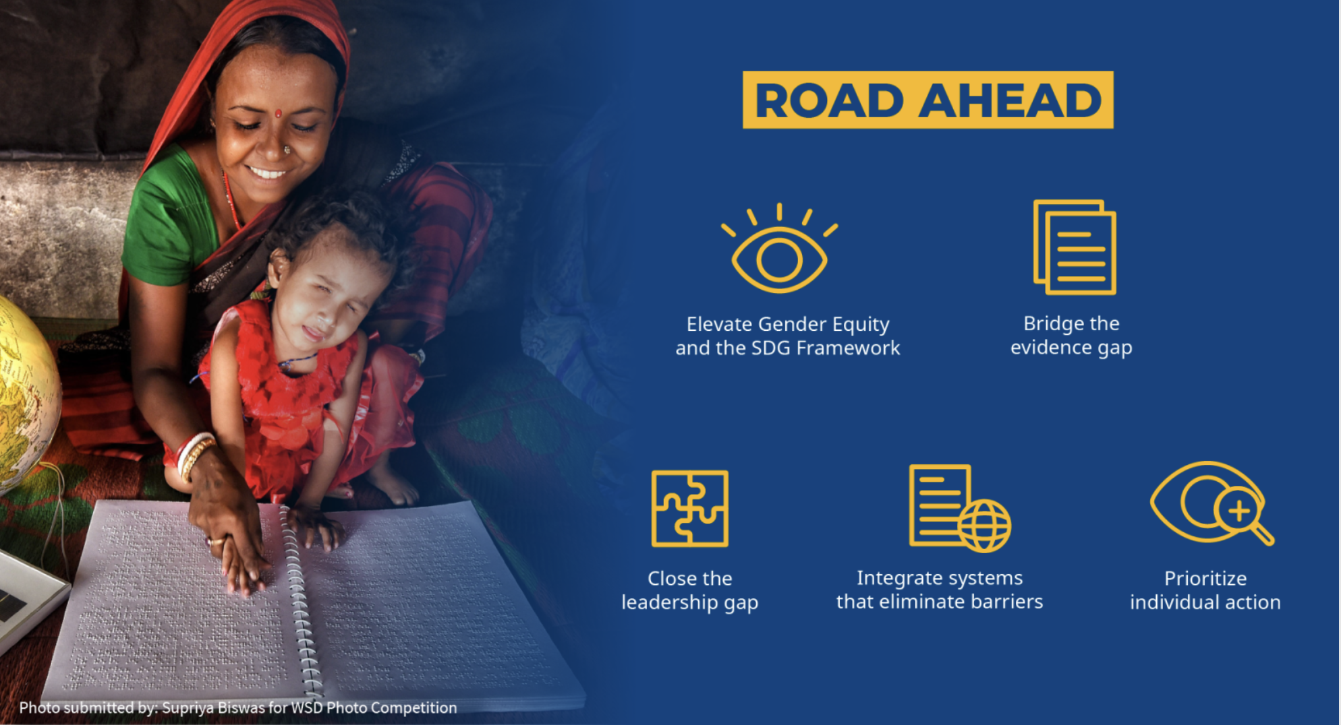
Acknowledge and explore gender inequities in ophthalmology and where you serve
Individually, consider unconscious biases and identify ways to mitigate them to improve the health and outcomes of your patients
Seek out mentorship/mentee opportunities
Reflect upon “who” is in the room when decisions are being made
Explicitly center women and marginalized communities in your work by honoring their needs and voices – partner whenever possible!
Create sustainable pipelines for girls and women to access education, care and leadership opportunities
WHAT CAN YOU DO?

Slide 26
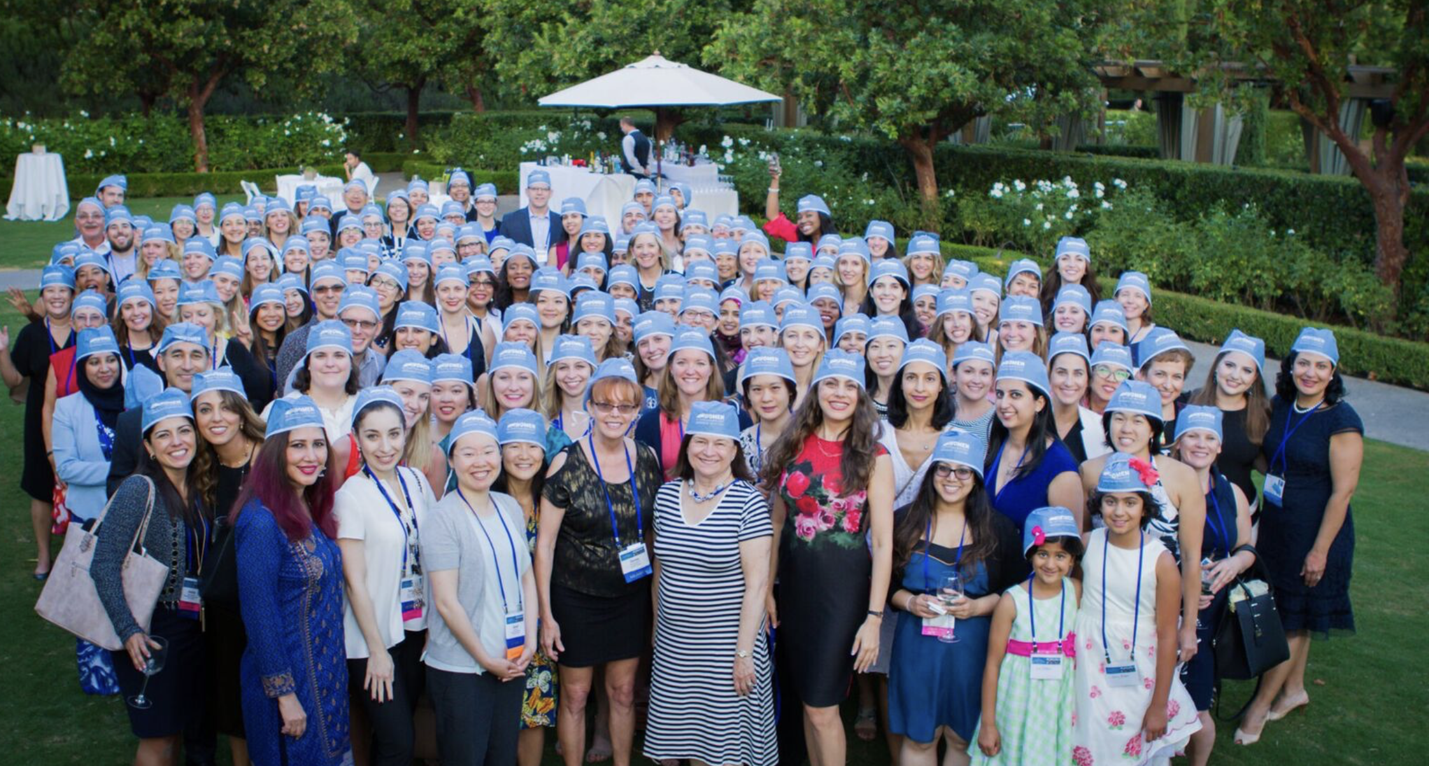
THANK YOU
Acknowledgments
Fasika Woreta, MD
Erin Shriver, MD
M.E. Hartnett, MD
Women in Ophthalmology

